Slide 1
Climate Ambitious Scenario for Mexico: EPS Modeling Results
CPL/Fletcher & ICM
October 2024

Slide 2
Scenario Policy Description

Slide 3
Scenarios
In the Business as Usual (BAU) baseline, Mexico continues with its current policies. These include a limited carbon tax, fuel subsidies, and no additional support for renewables and EVs. Emissions continue to rise as new low-carbon technologies (e.g. EV’s and renewables) have limited adoption.
In the Climate Ambition Scenario (CAS), Mexico transitions to renewable energy, increases energy efficiency, promotes a transition to EVs, improves the competitiveness of its industry, promotes more domestic purchasing, saves money on counter-productive fuel subsidies, and increases government revenue with a predictably increasing carbon tax.

Slide 4
CAS Cross Sectoral Policies (market subsidies/taxes)
Subsidy reduction
Fuel subsidies for natural gas, diesel, gasoline, and kerosene will be steadily reduced by 2050. These reductions decrease government expenditures and also correct a market distorting signal.
The electricity subsidy that the Mexican government currently grants to residential users should be redirected instead to finance the implementation of residential solar photovoltaic systems throughout the country.
Carbon tax
The existing carbon tax is expanded to cover all sectors, differing from the existing limited sectoral coverage. The price rises from the existing $3.75USD/tonCO2e to $14 USD/tonCO2e by 2030. From 2030, the price continues an annual increase until a price of $90 USD/tonCO2e in 2050. The carbon tax revenue is used to reduce household taxes (50%), reduce payroll taxes (12.5%), pay down the national debt (12.5%), and increase the government’s general budget (25%).

Slide 5
CAS Electric Sector Policies
Mexico implements a renewable portfolio standard that targets:
40% by 2030, achieving generation of solar = 50.5 MW (72%) and wind 19.5MW (28%).
65% by 2050, achieving generation of solar = 146.7 MW (77%) and wind = 44.6 MW (23%).
The transmission grid is expanded by 27% by 2050 (compared to BAU) to support the deployment of renewable energies.
Maintenance and modernization of the grid is conducted to reduce by transmission and distribution losses by 5%.
Grid-scale battery storage is installed (25GW by 2050) to improve grid stability from intermittent renewable energies.

Slide 6
CAS Distributed Generation Policies
Building on Mexico’s existing programs to promote solar on homes and in communities:
Increase the near-term 2030 goal to 7GW of distributed solar. Assuming 60% is installed on homes, over 1.75 million rooftops will have solar, which provides families living in poverty with access to clean energy and reducing the cost of electricity by up to 20%.
By 2050 distributed solar will reach ~40 GW.
From a gender perspective, having access to clean energy sources can reduce the time women spend on tasks such as getting firewood or cooking with fossil fuels, which represents a danger to their health and safety and that of their children, and have more time for education or work opportunities (WHO, 2023; OLADE, 2019).

Slide 7
CAS Residential and Commercial Buildings Policies
Electrification policies and energy efficiency standards reduce residential sector emissions by ~70% by 2050 (below BAU).
Similarly, energy efficiency and electrification reduce commercial sector emissions by ~74% by 2050 (below BAU), including standards for electric appliances, cooling, and heating.
In rural areas, alternatives for cooking, heating, and lighting should be considered. For example, low-emissions stoves. (not modeled)

Slide 8
CAS Transport Policies
EVs
Mexico will phase in a EV sales mandate slowly from 2025-2050. By 2050, all new light duty vehicle sales will be EVs, and 90% of new heavy duty vehicle sales will be electric. Note: the vehicle fleet will still have gasoline/diesel vehicles until they are retired by choice.
For freight transport, the CAS combines EVs and switching to more sustainable modes of transport. Trains carry more freight that under BAU and EVs reduce emissions from the “last-mile” trucks.
Transport demand management
For cities, efficient and accessible electric or low-emission public transport should be promoted to reduce the use of private vehicles.
Fuel economy and emission standards
Fuel economy and emission standards for vehicles are more stringent goals, bringing them in line with the latest EPA 2024 standards. Supporting these standards cleans the air and helps decarbonize this sector.
Complying with these standards results in a 15% reduction of criteria pollutants compared to baseline.

Slide 9
CAS Oil and Gas Policies - Fugitive Emissions
According to PEMEX’s Sustainability Plan, 30% of the routine and fugitive emissions should be reduced by 2030 compared to 2030. CAS includes this 2030 goal and achieves a 100% reduction of fugitive methane emissions from the oil & gas sector by 2050.
Methane policies includes both the avoiding and capturing emissions in several sub-sectors of the oil & gas production and distribution chain (i.e. oil & gas extraction, gas processing, petroleum and coke refining).
To avoid fugitive emissions, it is key enforce existing regulations throughout the supply chain to reduce and eventually eliminate gas venting and flaring.
PEMEX’s target is promising, however, some studies suggest that methane emissions, and particularly, fugitive emissions from the oil and gas sector are highly underestimated (UNEP, 2022). This is why taking immediate action to reduce and avoid fugitive emissions is crucial, and it has the potential to generate other co-benefits in terms of improving health and safety, and inclusion for workers, and communities living around, reducing water and soil pollution. It also represents a low cost measure with no negative impacts on jobs.

Slide 10
CAS Oil and Gas - Cogeneration Opportunities
Investing in cogeneration and heat recovery technologies to achieve process efficiency reduces emissions, particularly in refining processes.
With cogeneration and heat recovery, efficiency from a traditional process can go from 64% up to 80%. The benefits of improving efficiency through cogeneration, includes reducing costs significantly on electricity and fuels (natural gas and fuel oil) used in the processes.
There is a potential for PEMEX to generate 4,500 MW through cogeneration by 2030. However, to achieve this target, clear operation rules from CRE and private investments should be in place. (not modeled)

Slide 11
CAS Industrial Policies (1)
Industrial policies in the Climate Ambition Scenario include:
Changing cement production inputs to reduce “clinker” emissions.
Energy savings from early retirement of inefficient industrial facilities, whose output is assume to be replace by other existing or new facilities (15% by 2050).
Implementation of Mexico’s Kigali Amendment pledge with policies on F-gas destruction and substitution (80% target by 2045).
Electrification of the manufacturing and chemical industries up to 60% by 2050.
Use of hydrogen as an alternative fuel in steel, cement, manufacturing, chemical, mining, and oil & gas industries up to 40% by 2050.
Cogeneration and waste heat recovery up to 75%.

Slide 12
CAS Industrial Policies (2)
Increasing consumption of goods produced in Mexico (“Buy Mexican”), instead of importing:
Chemicals (10%)
Food beverage and tobacco (20%)
Other mining and quarrying (10%)
Refined petroleum (10%)
Textiles (10%)
Cements (20%)
Implement carbon capture and storage (CCS) in particular industries:
Natural gas nonpeaker (45%)
Gas peaker (45%)
Cement and other nonmetallic minerals (90%)
Chemicals (70%)
Iron and steel (90%)
Manufacturing (40%)
Petroleum and coke refining (90%)

Slide 13
CAS Industry - Equipment Efficiency Standards & CCS
Improvement in equipment efficiency standards
Agricultural processes - 50%
Cement and other non-metallic minerals + mining - 40%
Chemicals - 10%
Coal mining - 30%
Construction 20%
Pipelines and gas processing - 30%
Food and manufacturing - 30%
Iron and steel 30%
Petroleum and coke refining 25%
CCS to start implementation for key industries in 2035:
Natural gas nonpeaker - 45%
Gas peaker - 45%
Cement and other nonmetallic minerals - 90%
Chemicals - 70%
Iron and steel - 90%
Manufacturing - 40%
Petroleum and coke refining - 90%

Slide 14
CAS Agriculture, Forestry, and Land Use (AFOLU)
Agriculture, through livestock emissions, accounts for half of the country's methane emissions. The potential is estimated using a bottom-up approach, based on the characteristics of agricultural production units.
Policies to avoid methane release include promoting sustainable agriculture practices for crops and rice production. Addition policies help industry shift to sustainable livestock production.
Forest management improvement and reforestation policies are expanding with ambitious goals by 2050.
Natural Protected Areas (forest-set aside) → 32.89 million hectares
Reforestation → 7.04 million hectares
Forest management improvement → 20.60 million hectares
Deforestation emissions are reduced by 70%.
Finally, CAS assumes that 15% of animal products are shifted to non-animal products by 2050, meaning that, on average, society consumes less dairy and meat.
Notes:
Deforestation emissions are reduced 70%, cropland, rice reduction

Slide 15
CAS Waste Sector Policies
The waste sector accounts for 28% of Mexico’s methane emissions today.
In the CAS scenario, we considered that all of the waste sector methane emissions are captured by 2050.
Gas flaring is no longer considered a good practice internationally, so the regulation should include eliminating this process, which is still very common in Mexico, as well as the closing of landfills that do not comply with the infrastructure to operate according to NOM-163.
Waste heat recovery is set at 75%.
Additionally, N2O abatement measures are taken, since it has a warming potential 273 bigger than CO2. This GHG is produced by some waste water treatment processes, such as active sludge.

Slide 16
Modeling Results

Slide 17
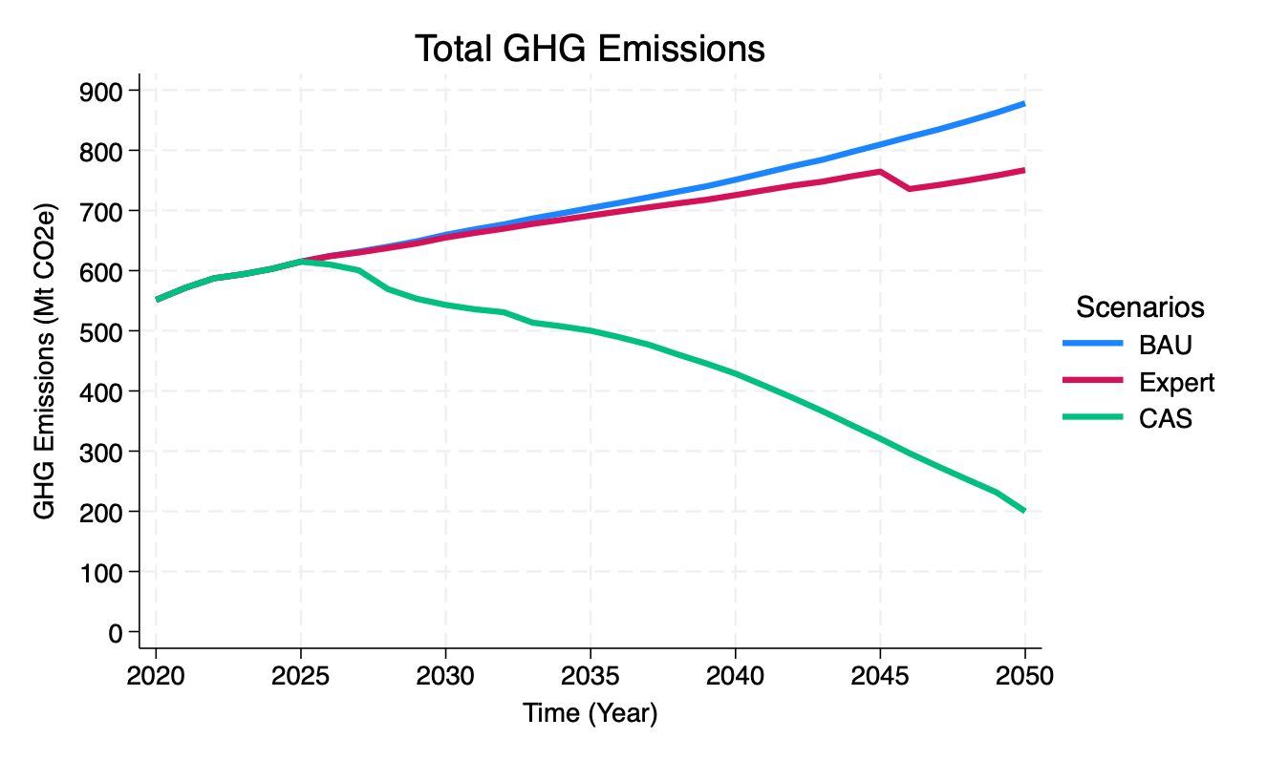
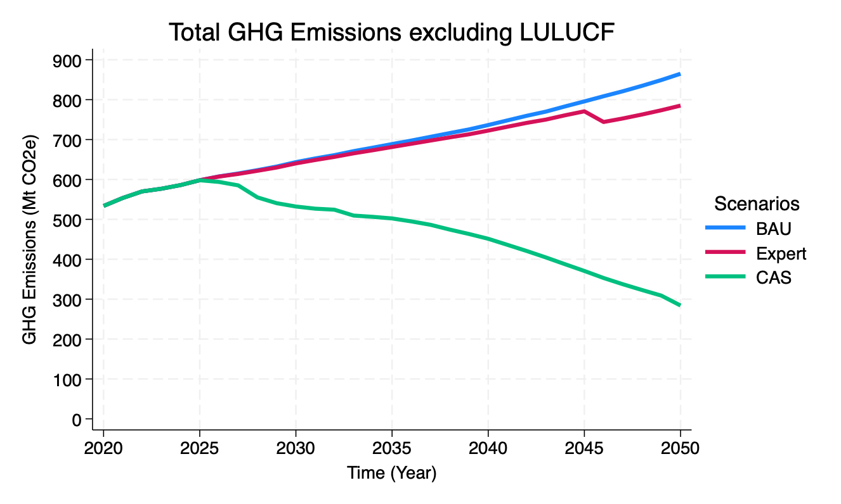
17.3% decrease in emissions by 2030
0.7% decrease in emissions by 2030
0.5% decrease in emissions by 2030
12.6% decrease in emissions by 2030
9.2% decrease in emissions by 2030
16.9% decrease in emissions by 2030
66.9% decrease in emissions by 2030
77.1% decrease in emissions by 2030

Slide 18
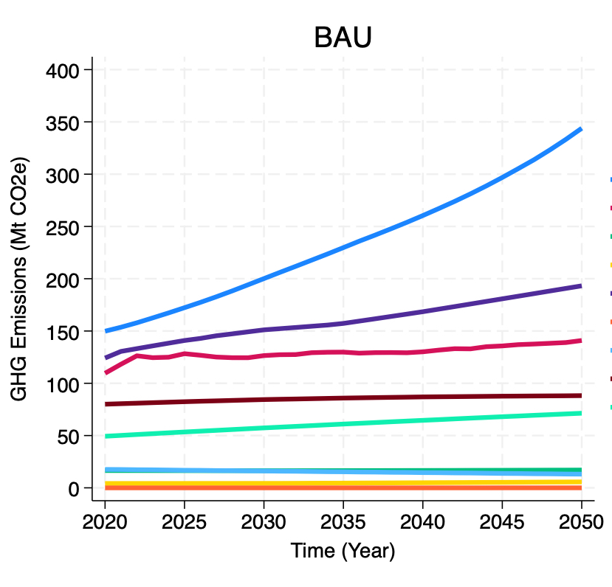
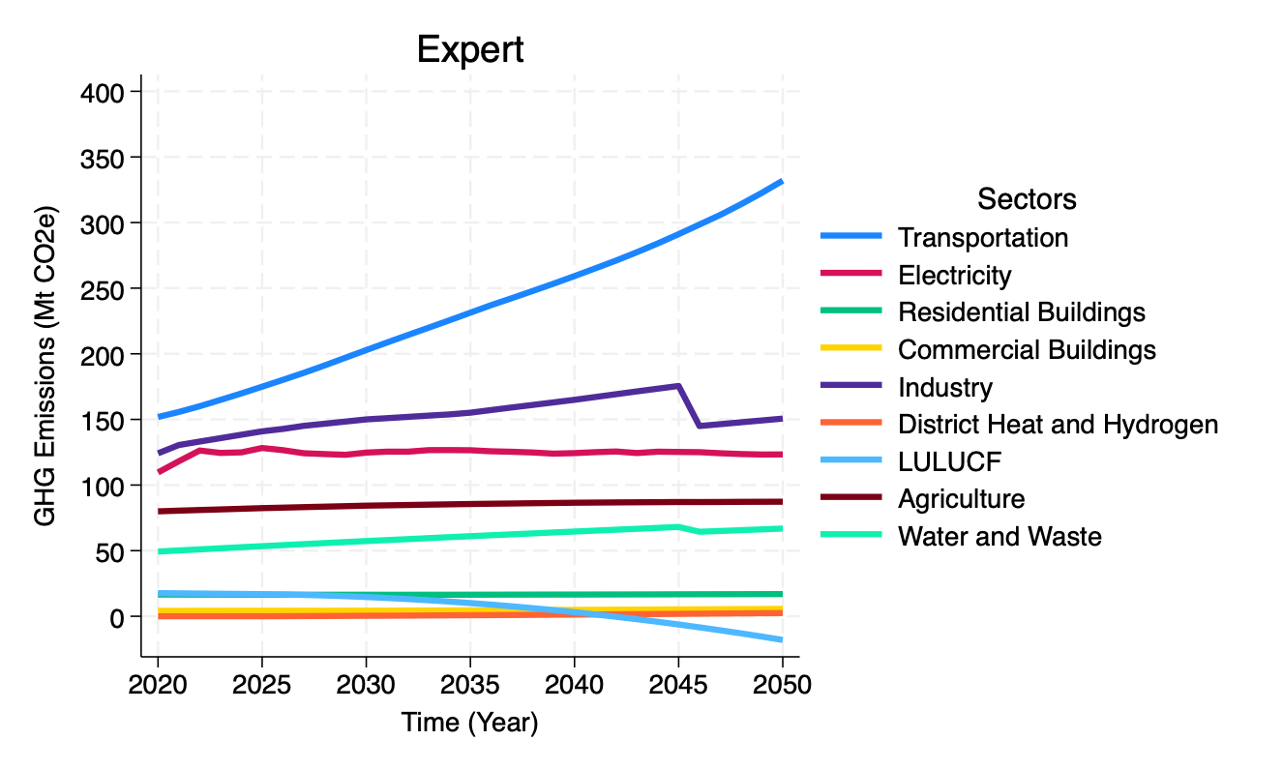
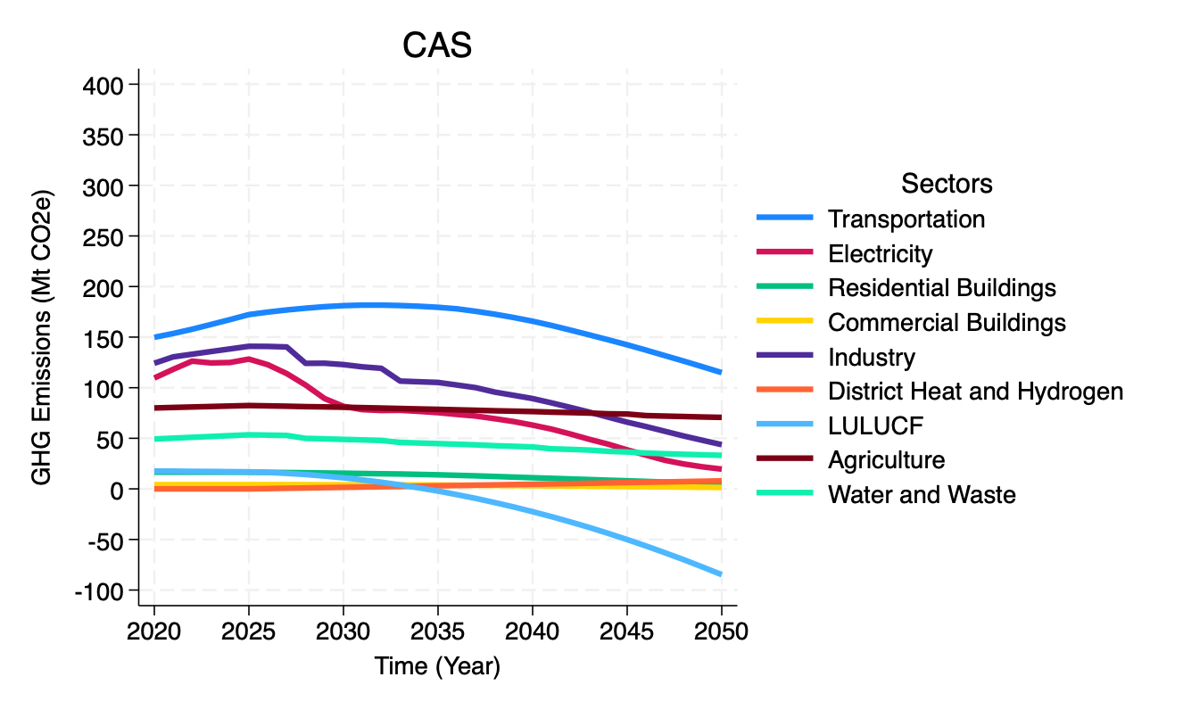

Slide 19
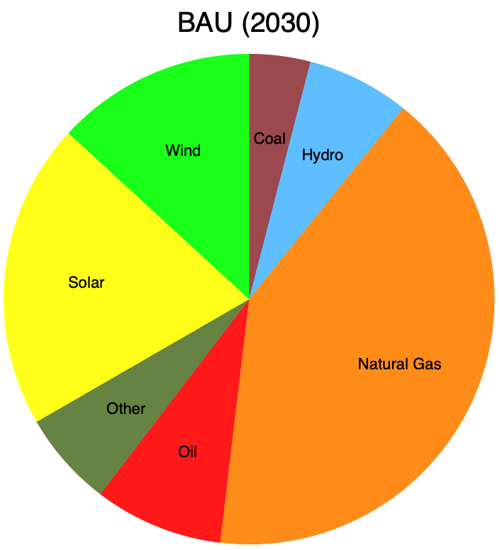
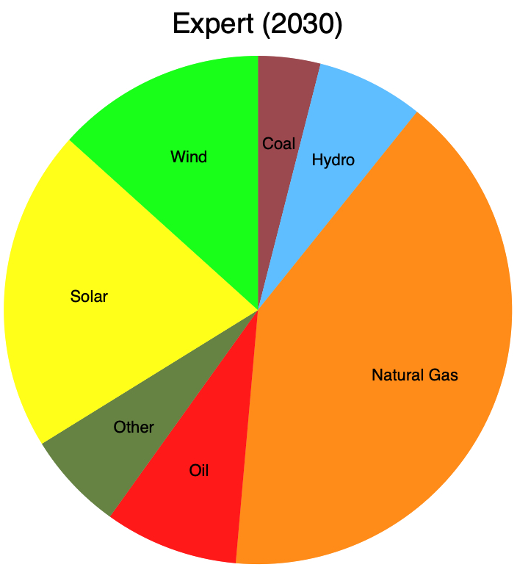
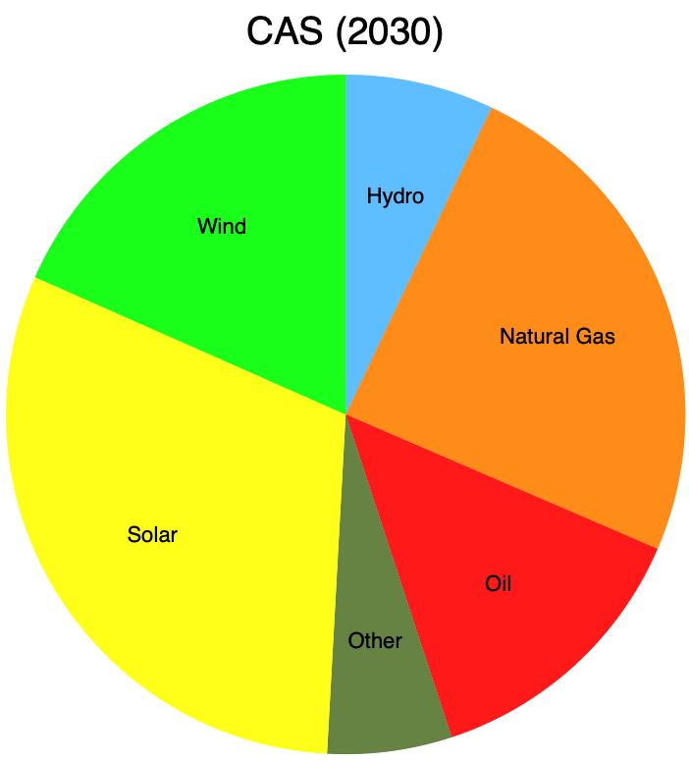
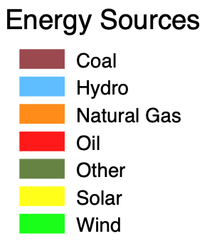
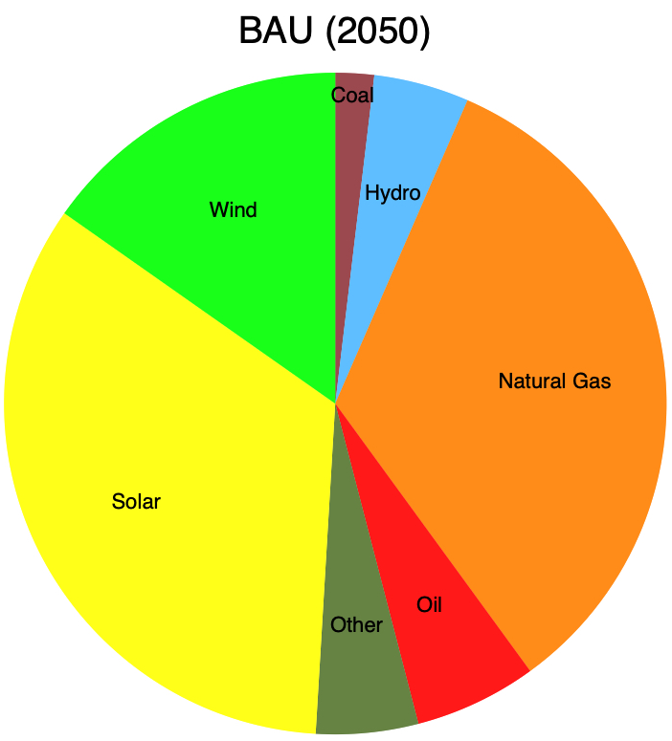
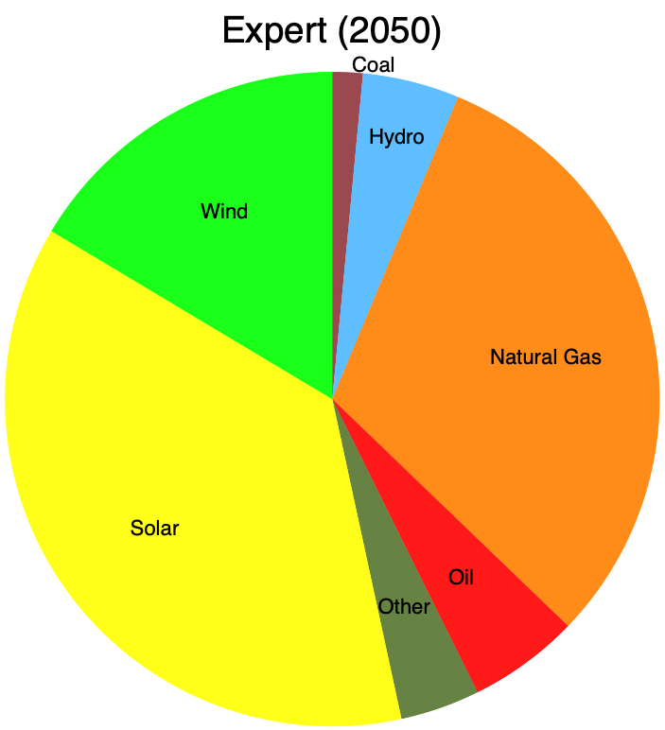
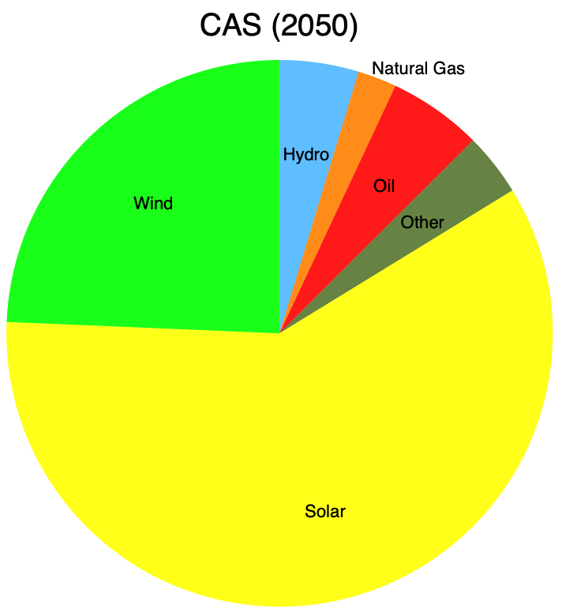

Slide 20
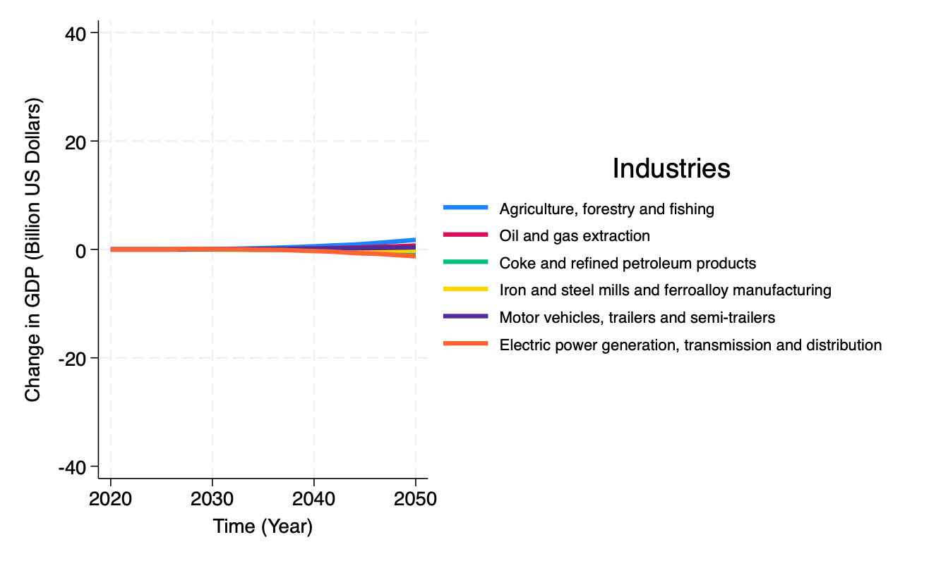
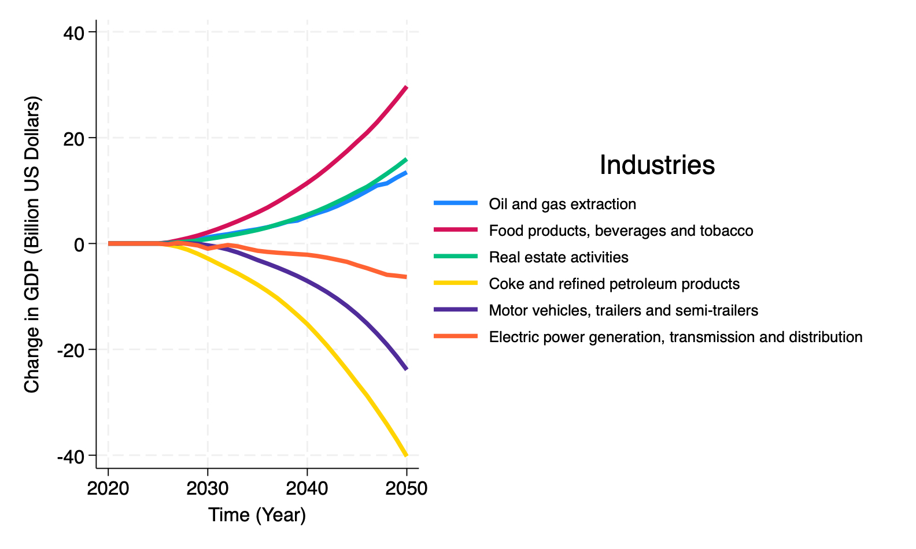
Expert
CAS

Slide 21
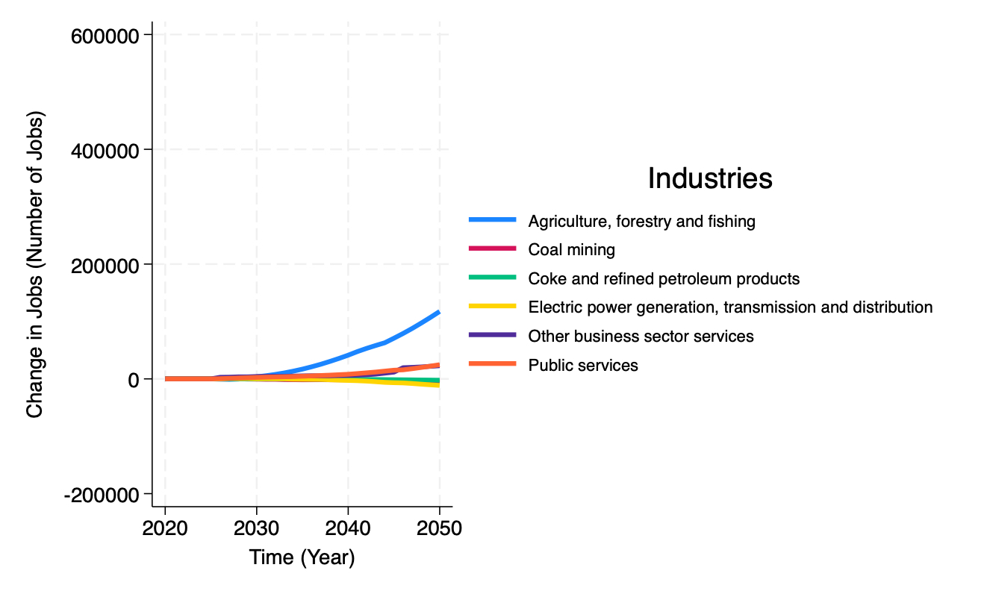
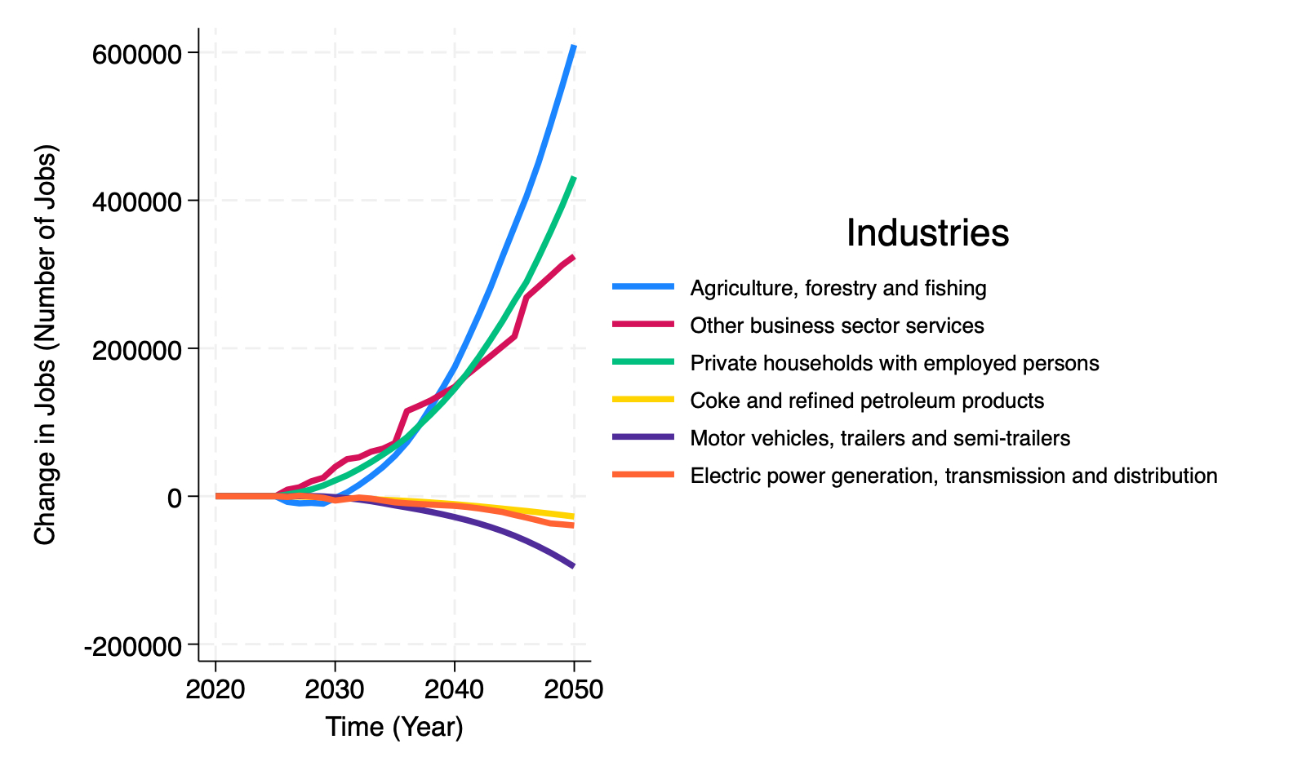
CAS
Expert
CAS

Slide 22
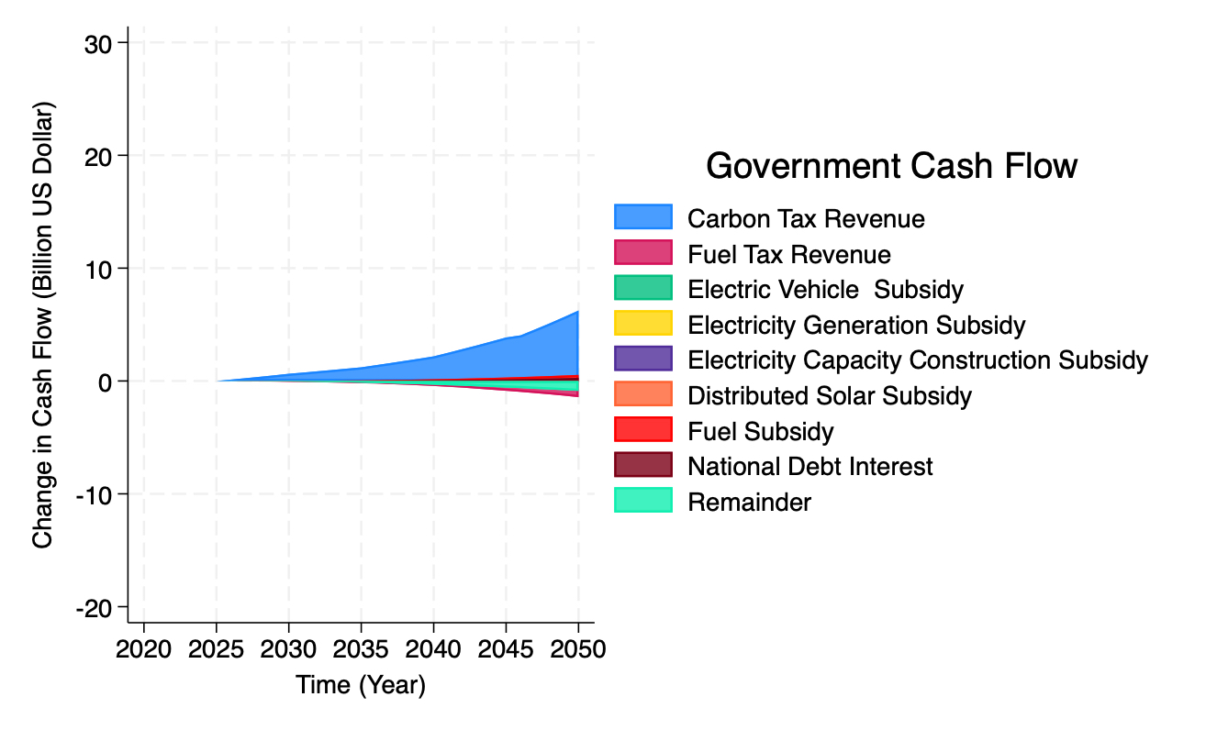
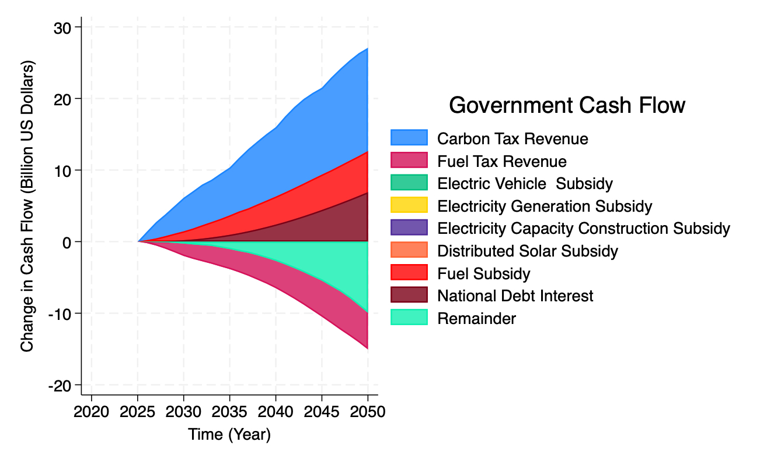
Expert
CAS

Slide 23
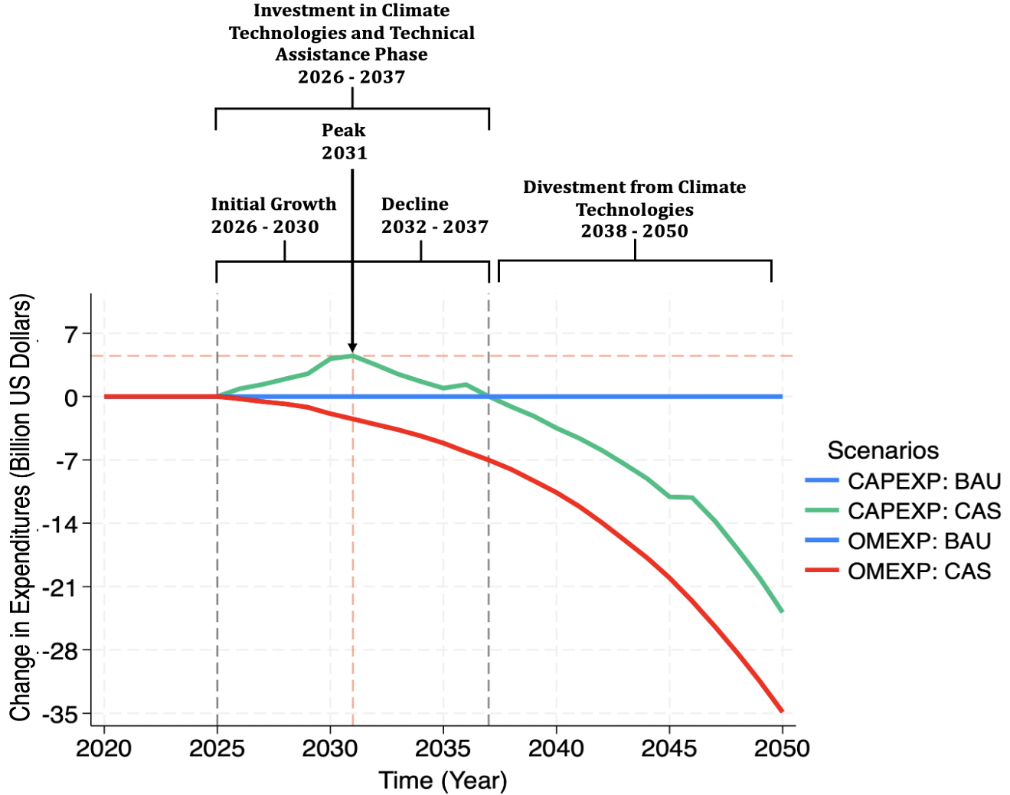
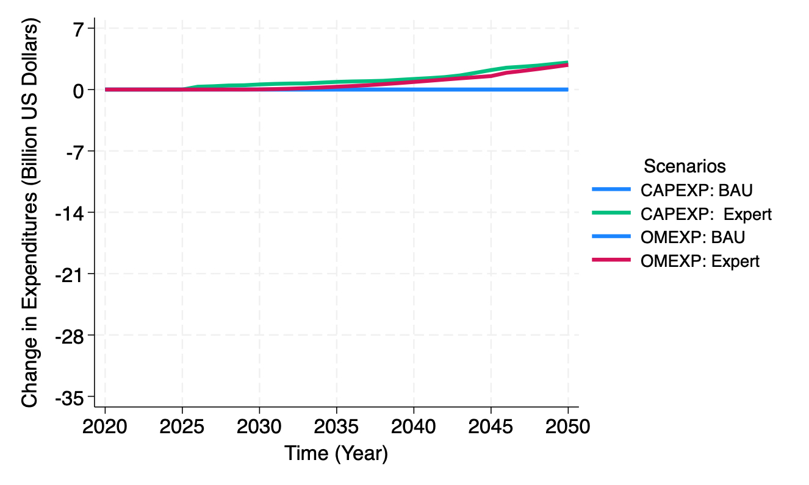
Expert
CAS
Spending Intensification
2026 - 2050

Slide 24
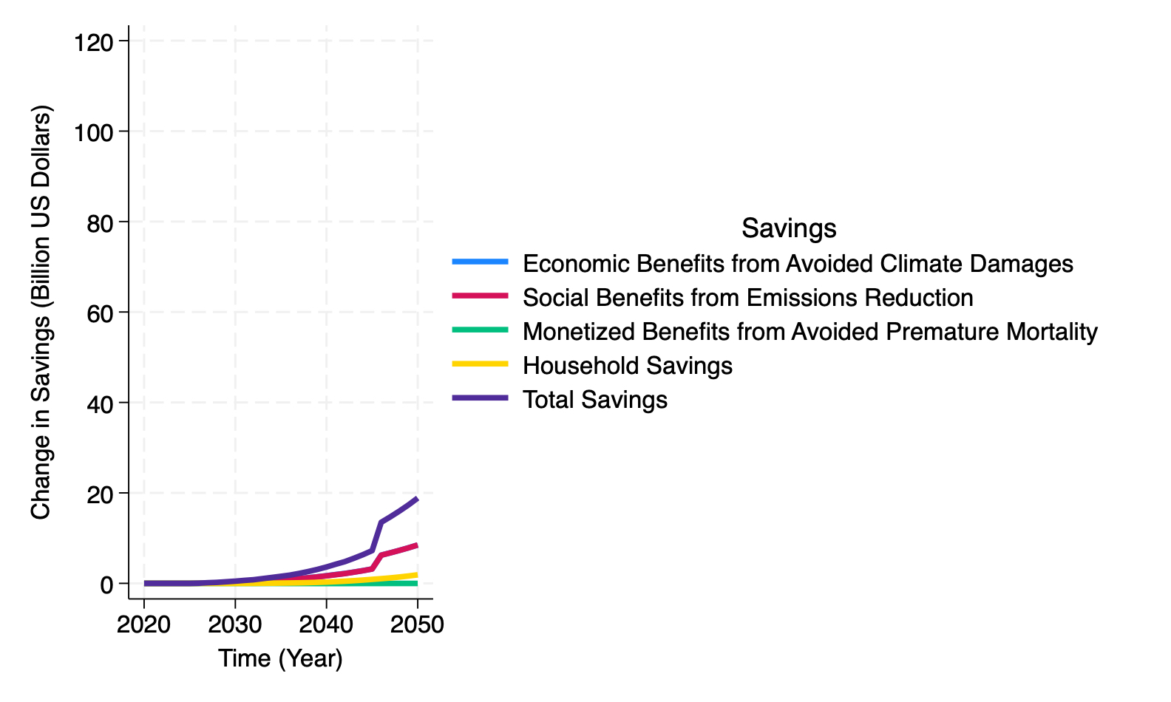
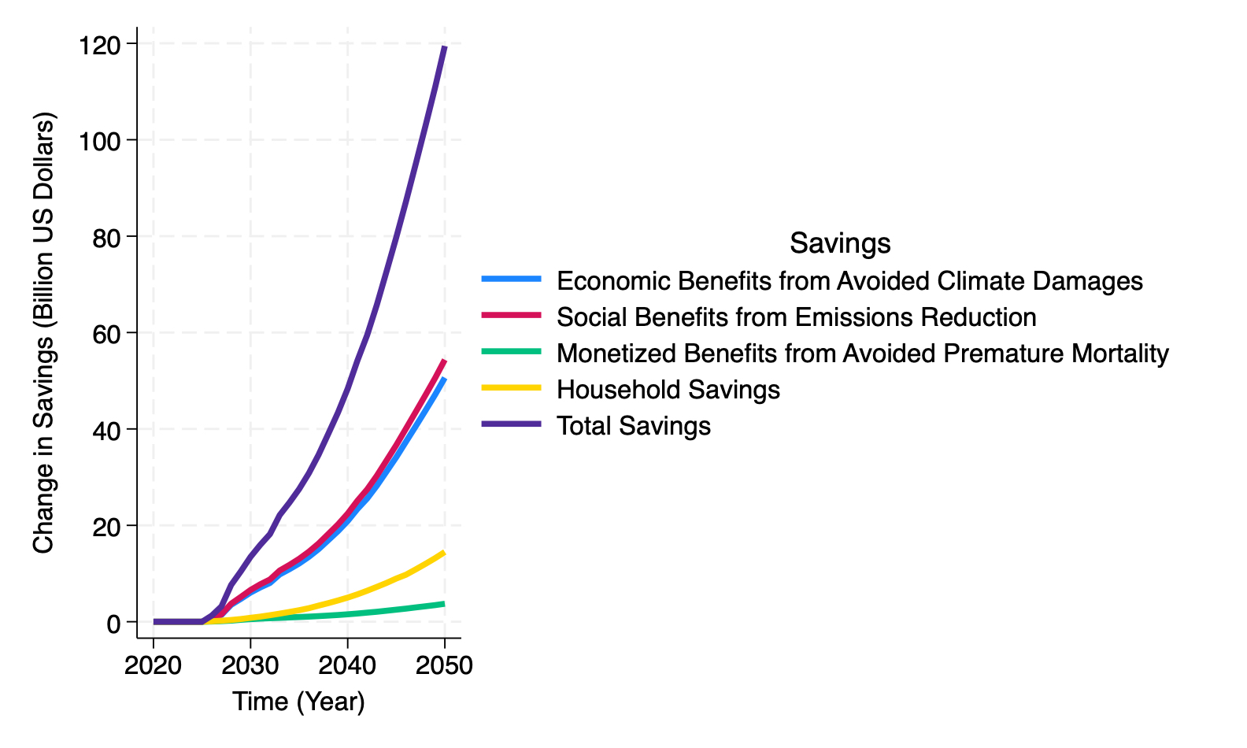
Expert
CAS

Slide 25
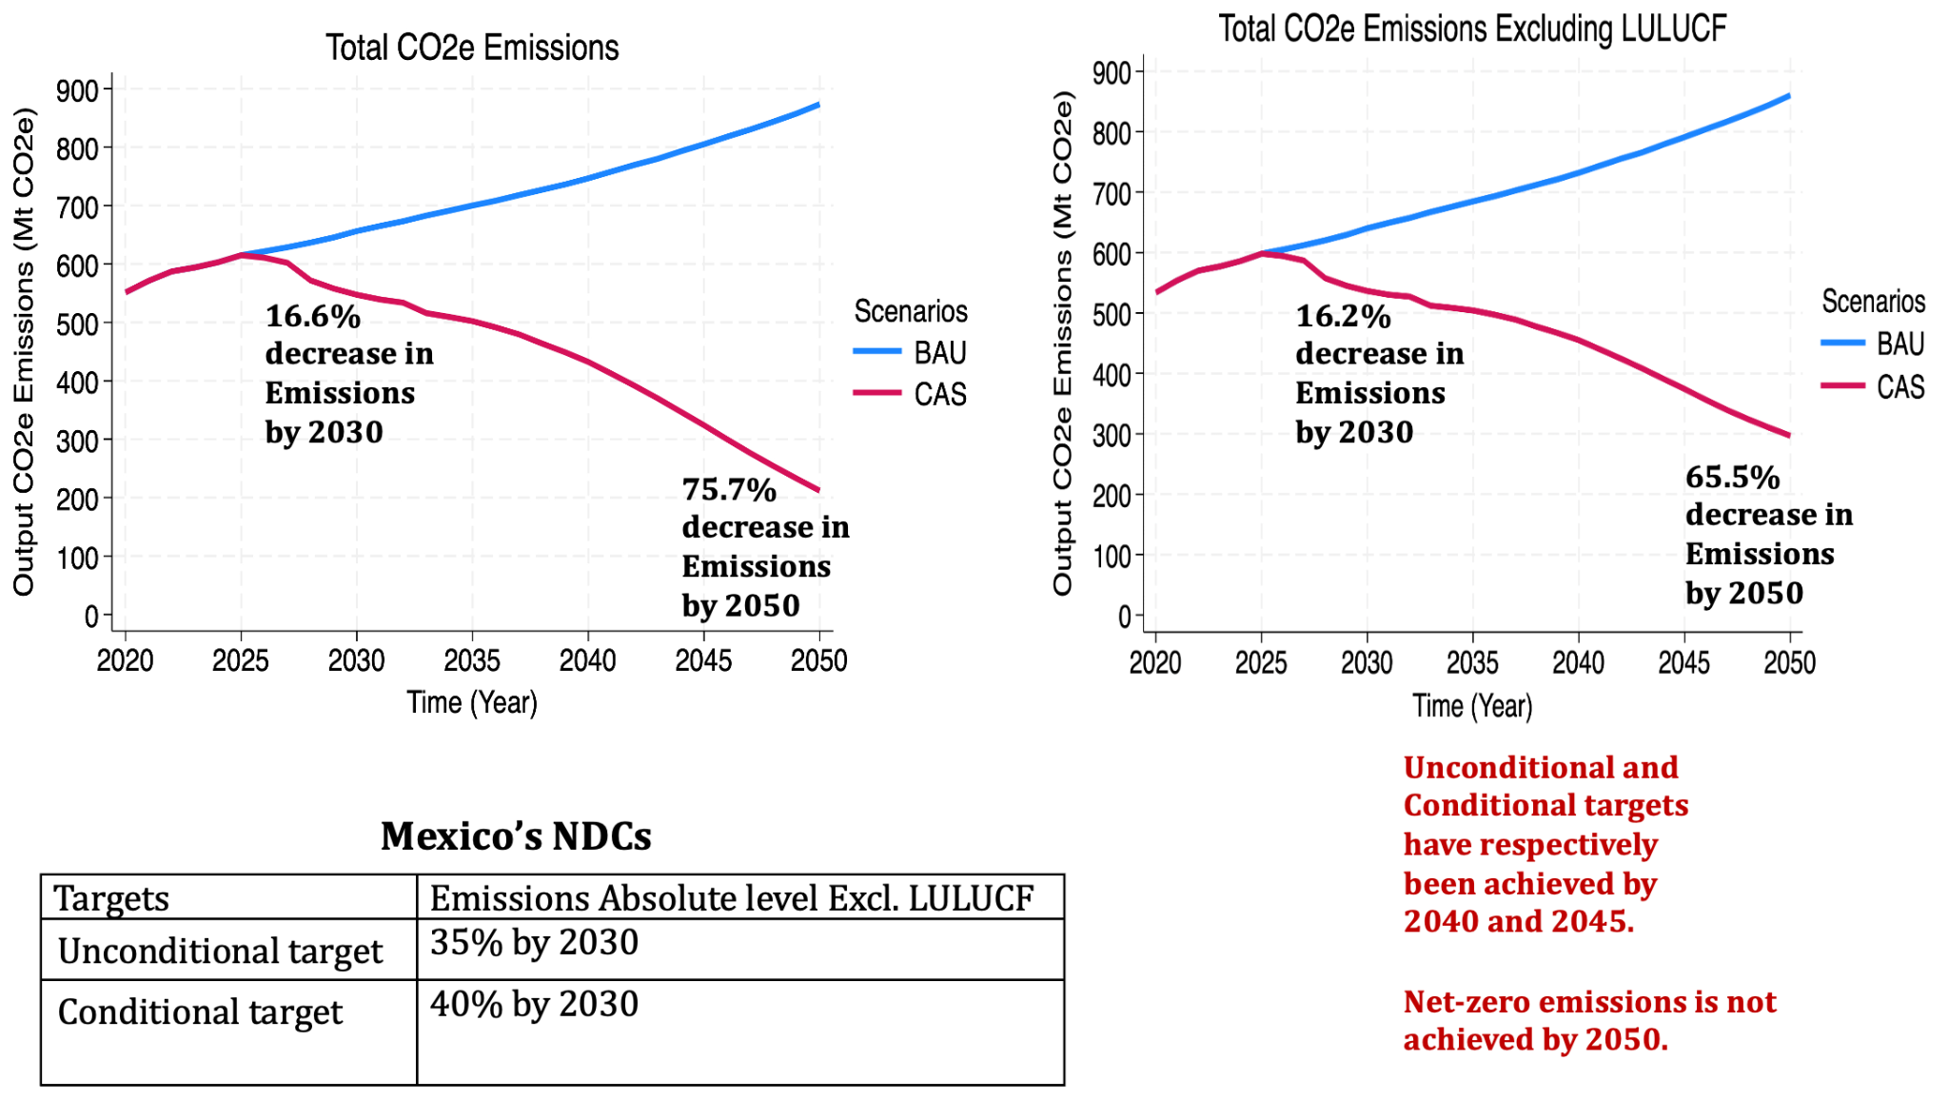
Mexico’s Total CO2e Emissions

Slide 26
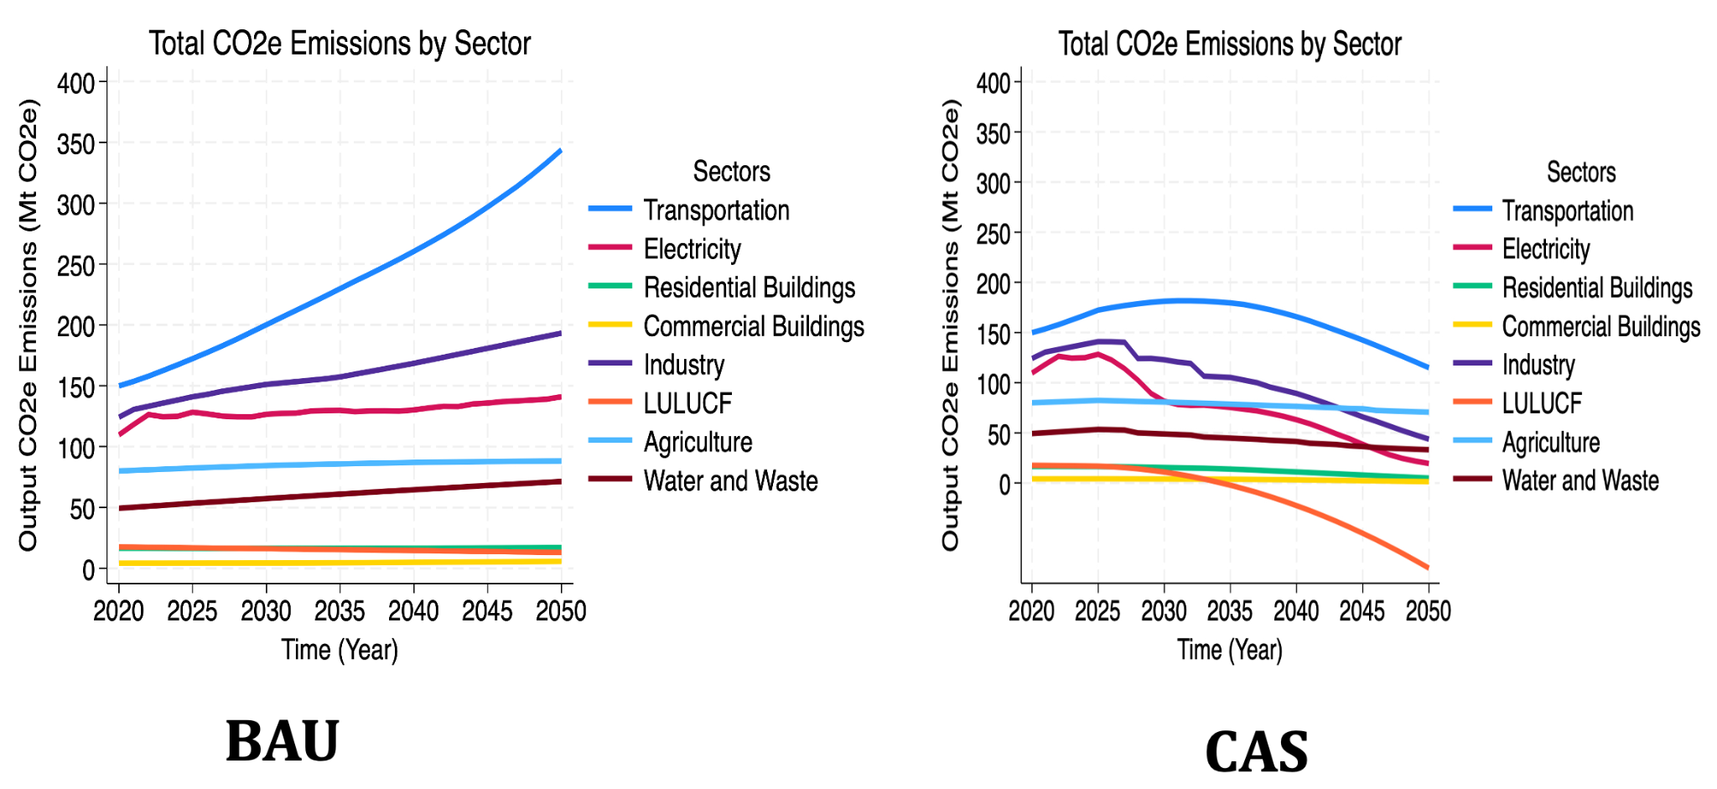
CO2e Emissions by Sector

Slide 27
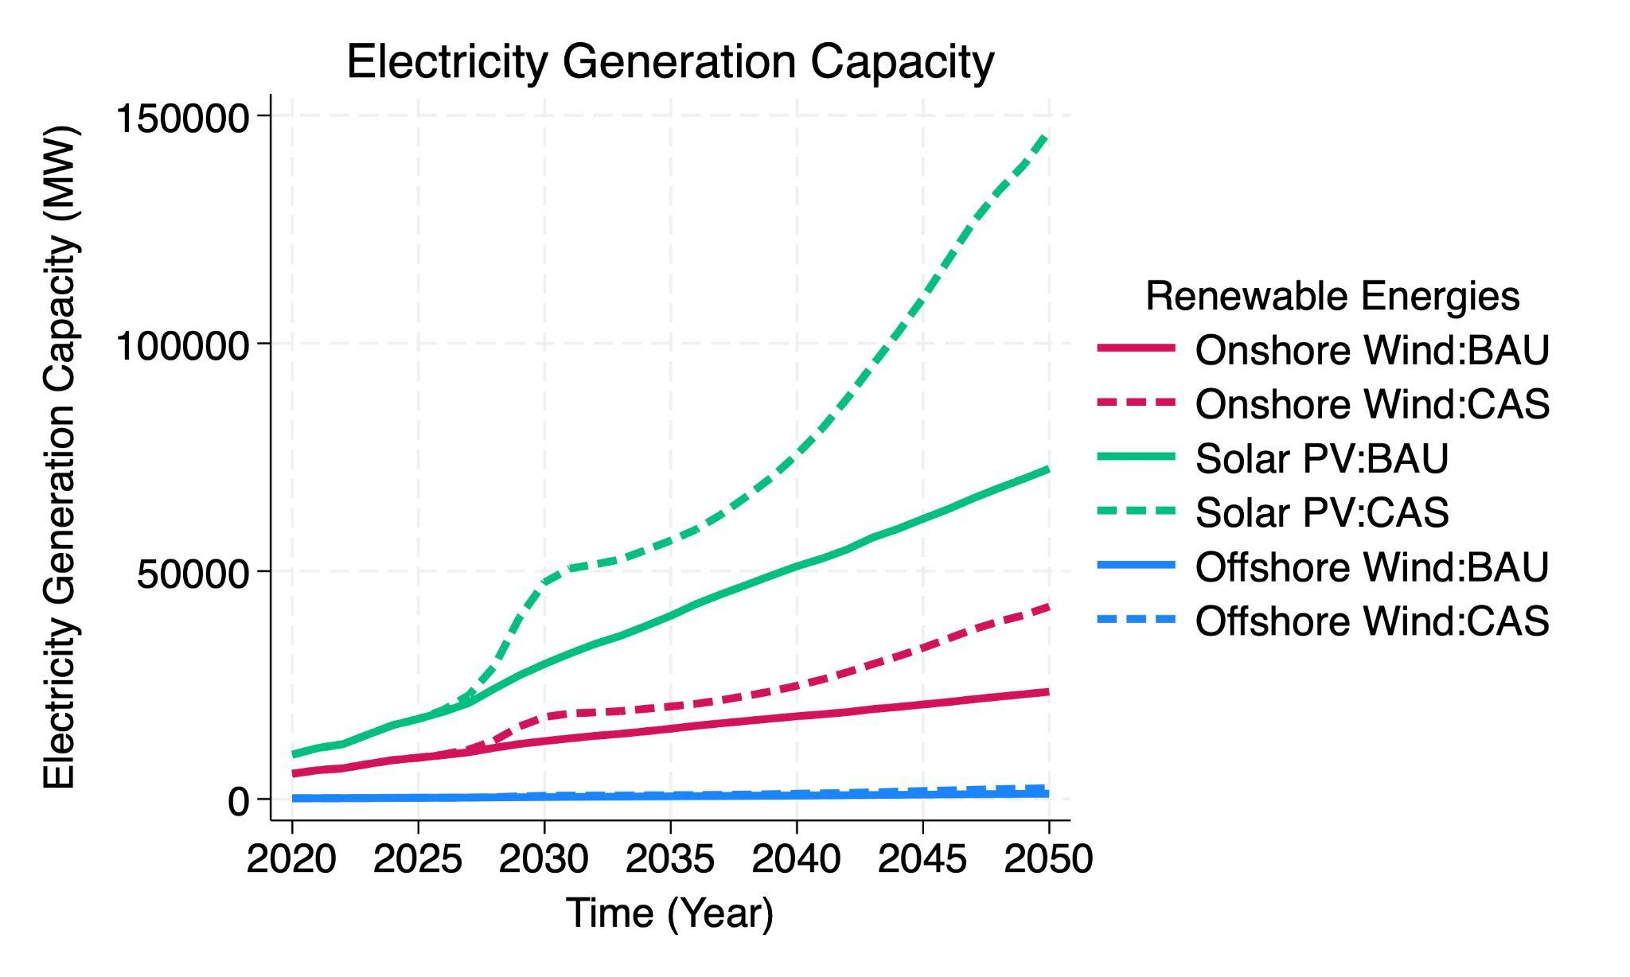
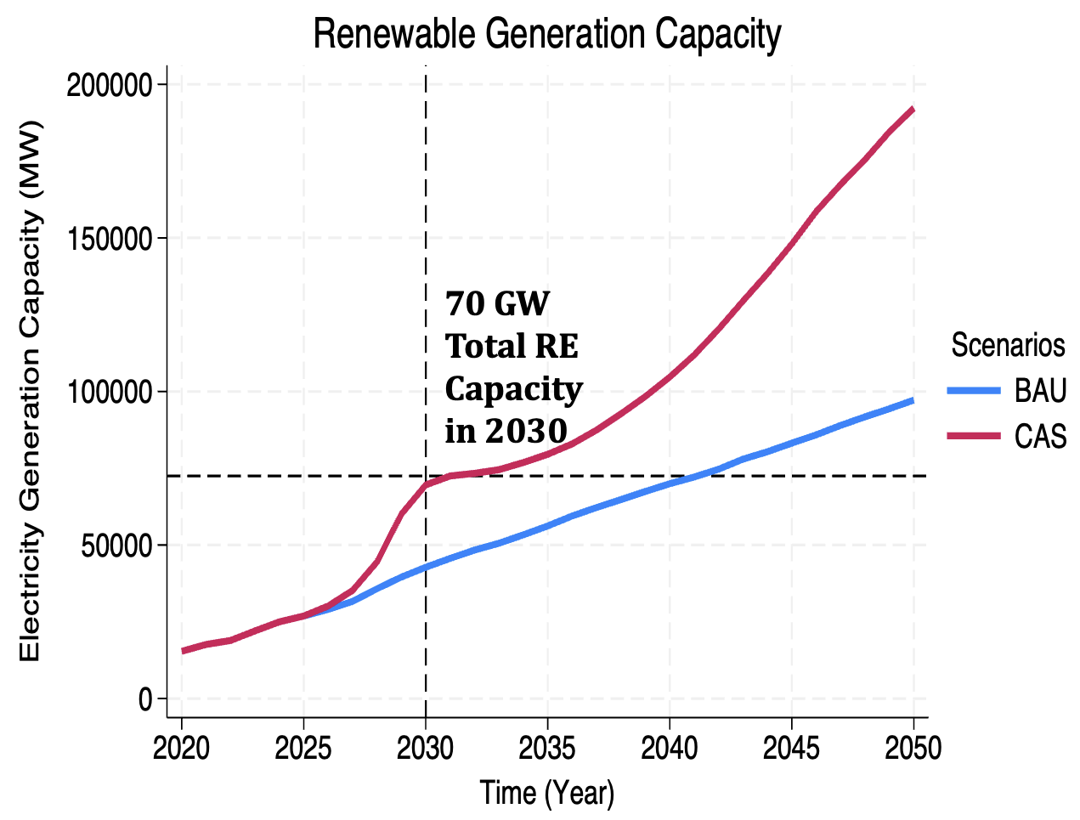
Electricity Generation Capacity - Renewables

Slide 28
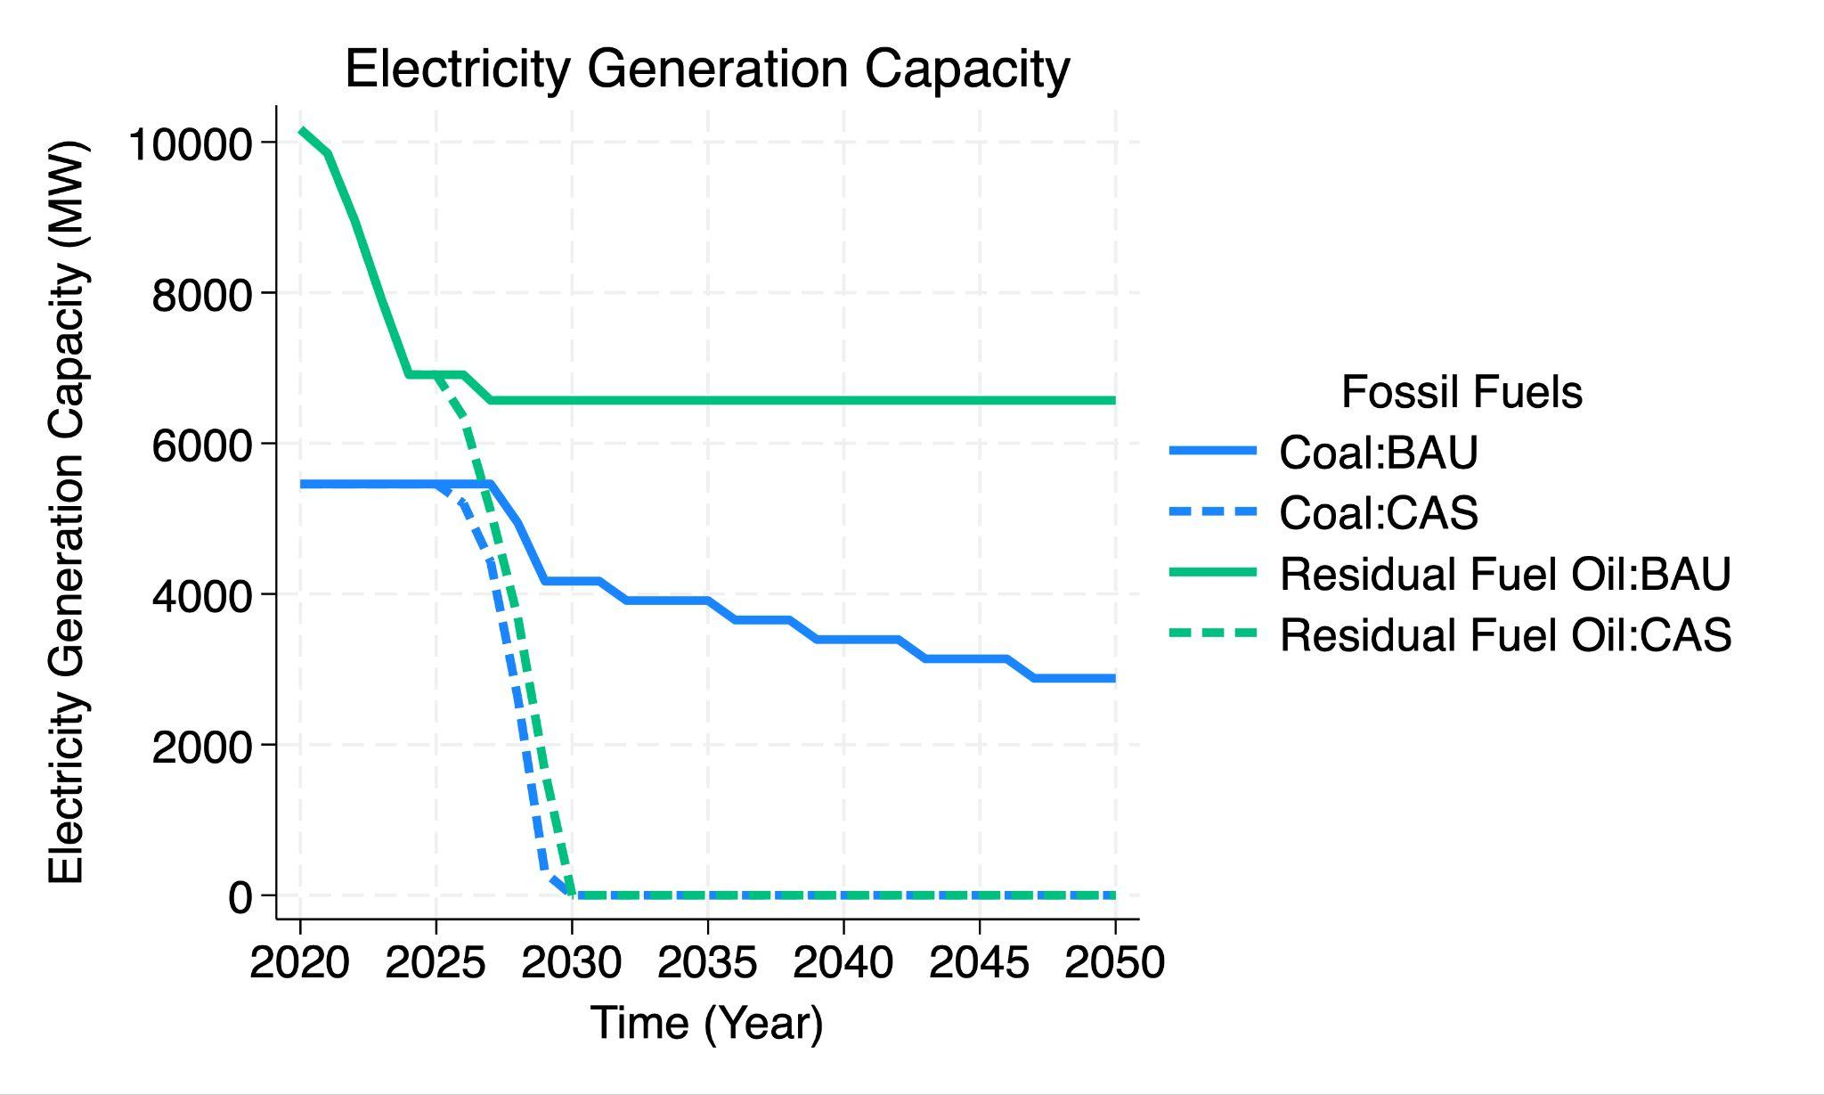
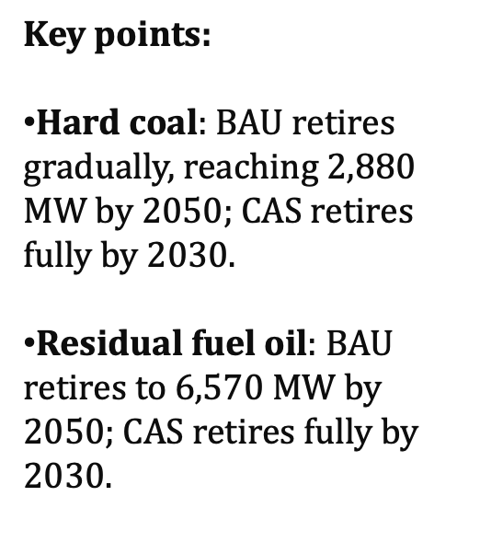
Electricity Generation Capacity - Fossil fuels

Slide 29
Electricity Generation Capacity - Fossil fuels vs. RE
Generation Groupings:
Natural Gas
Hydro
Wind
Solar
Coal
Oil (What do you mean by oil? Is it crude oil or residual fuel oil? Or both?)
Other (Biomass, nuclear, geo)
For years 2020, 2030, 2050
INSERT PIE CHARTS HERE

Slide 30
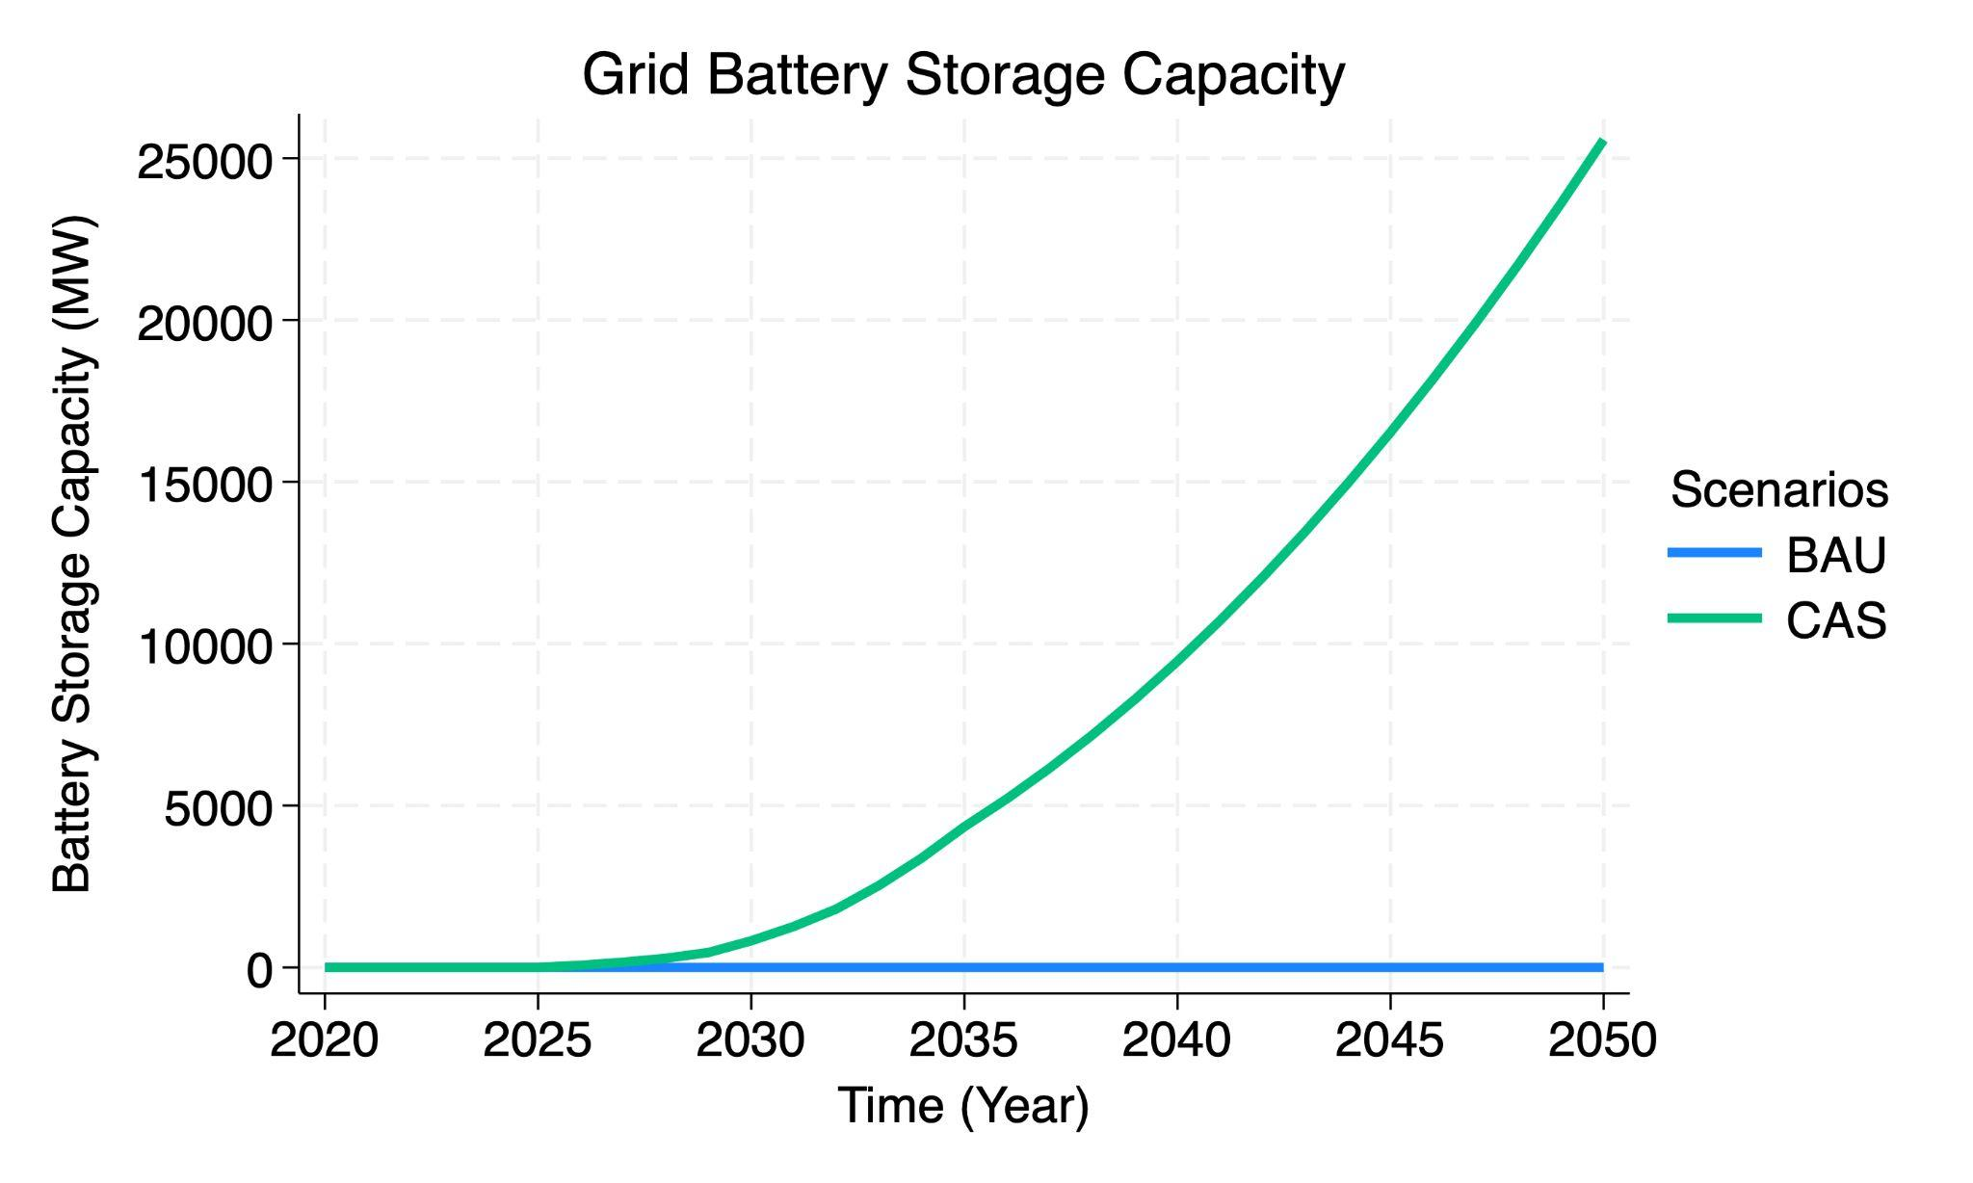
Grid Battery Storage Capacity

Slide 31
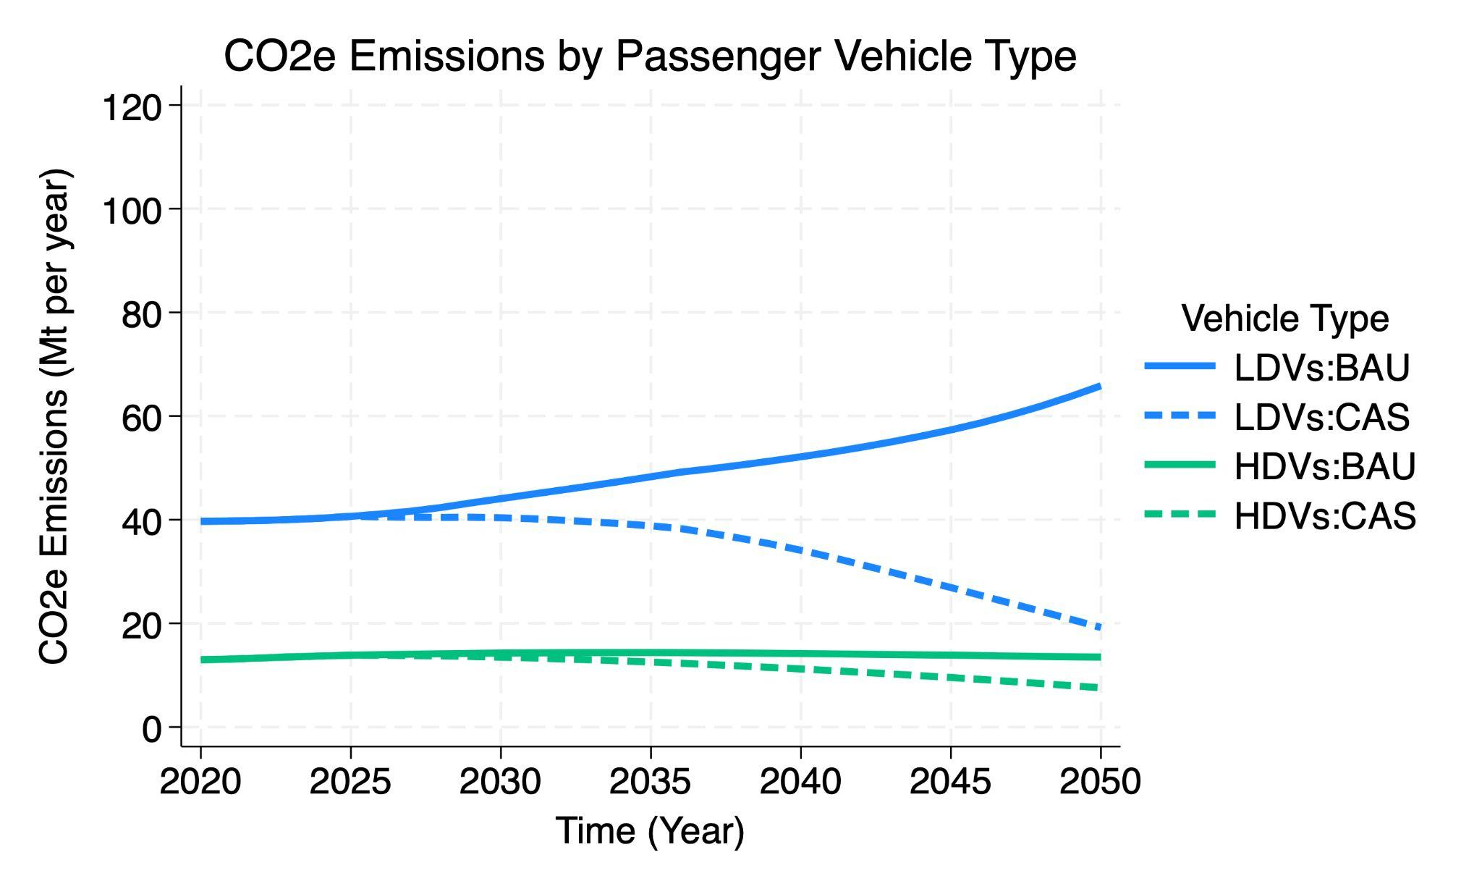
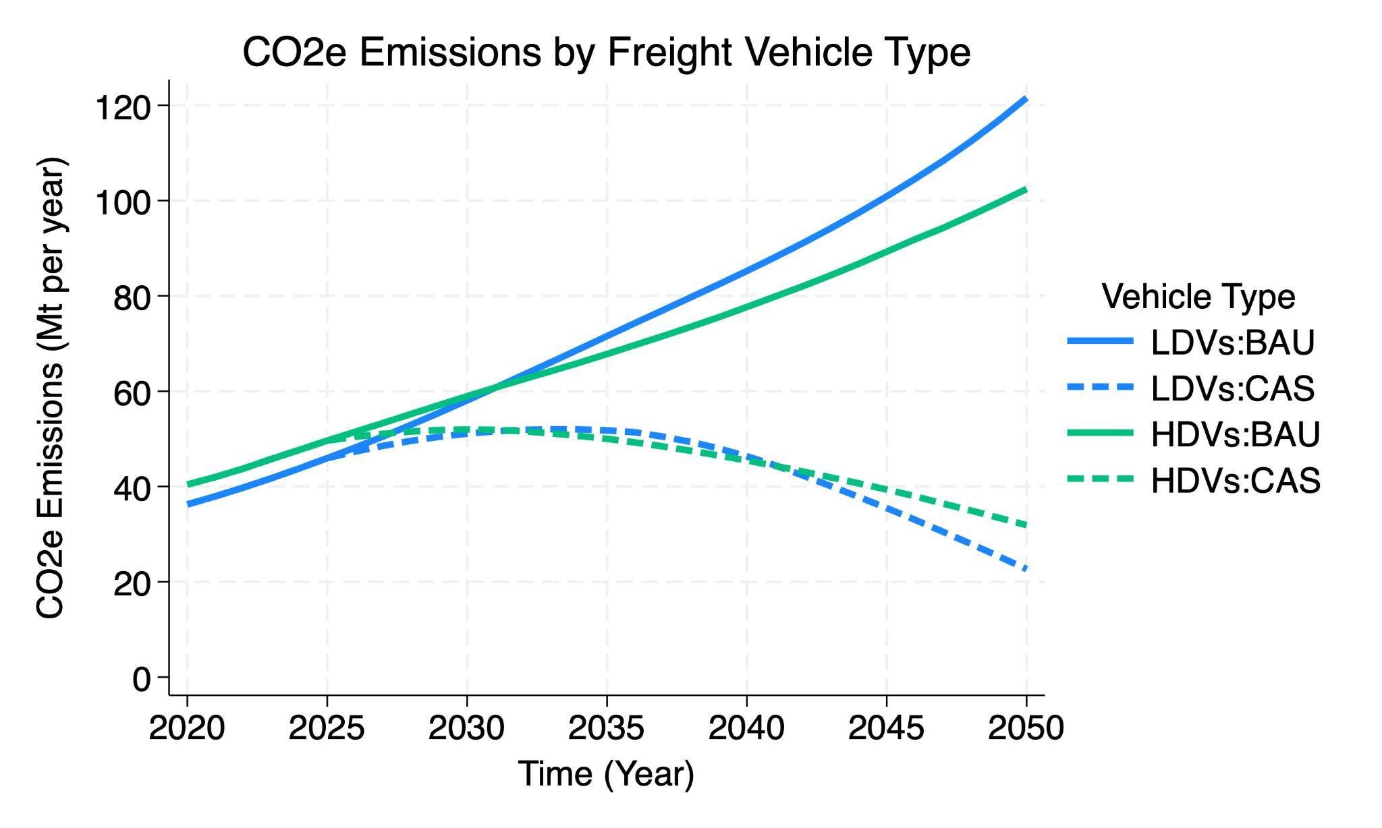
CO2e Emissions by Vehicle Type

Slide 32
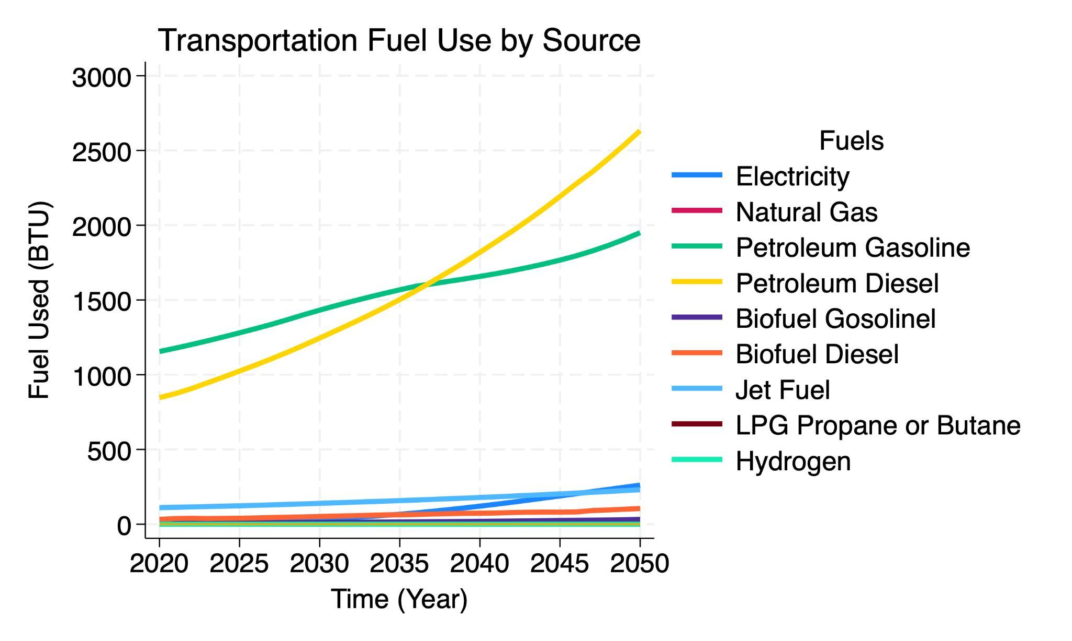
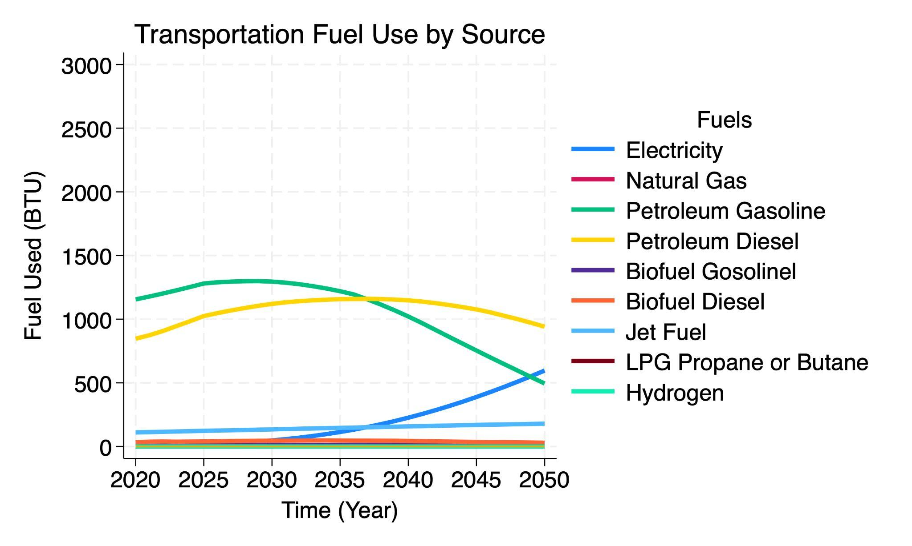


Transportation Fuel Use

Slide 33
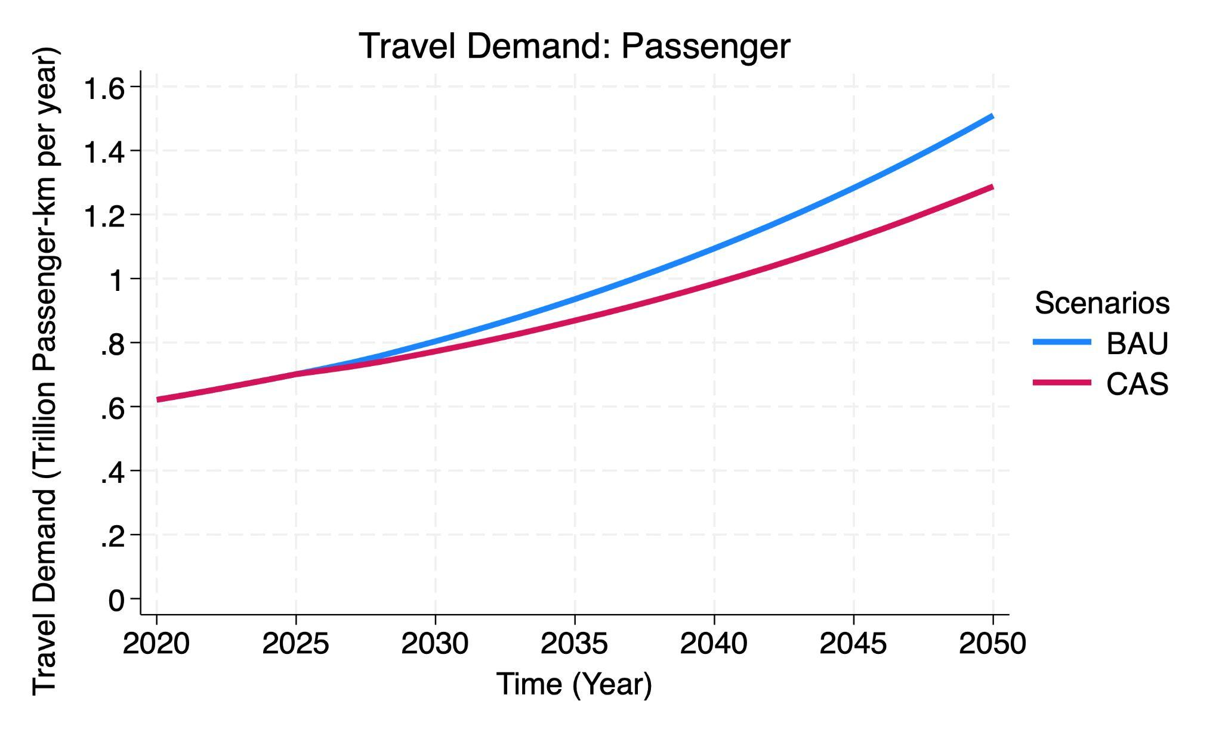
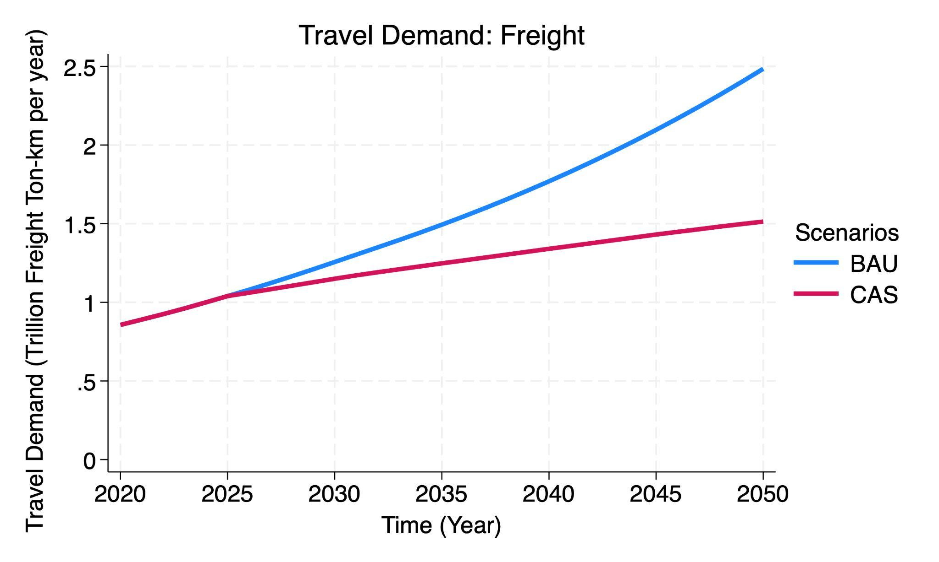
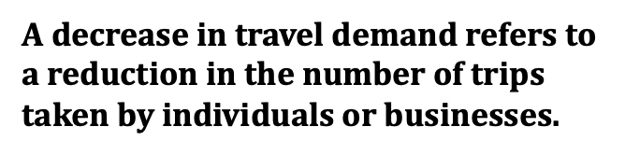
Transportation Demand

Slide 34
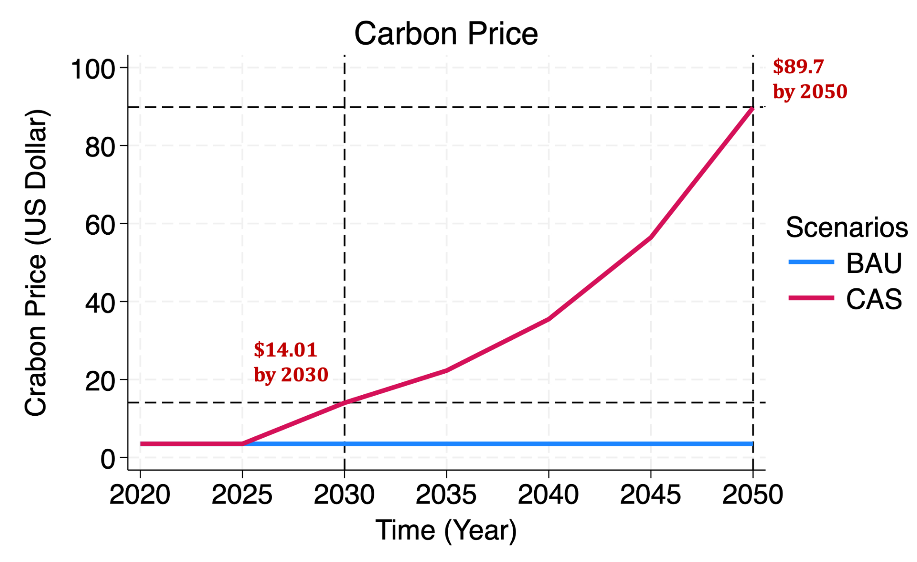
Carbon Price

Slide 35
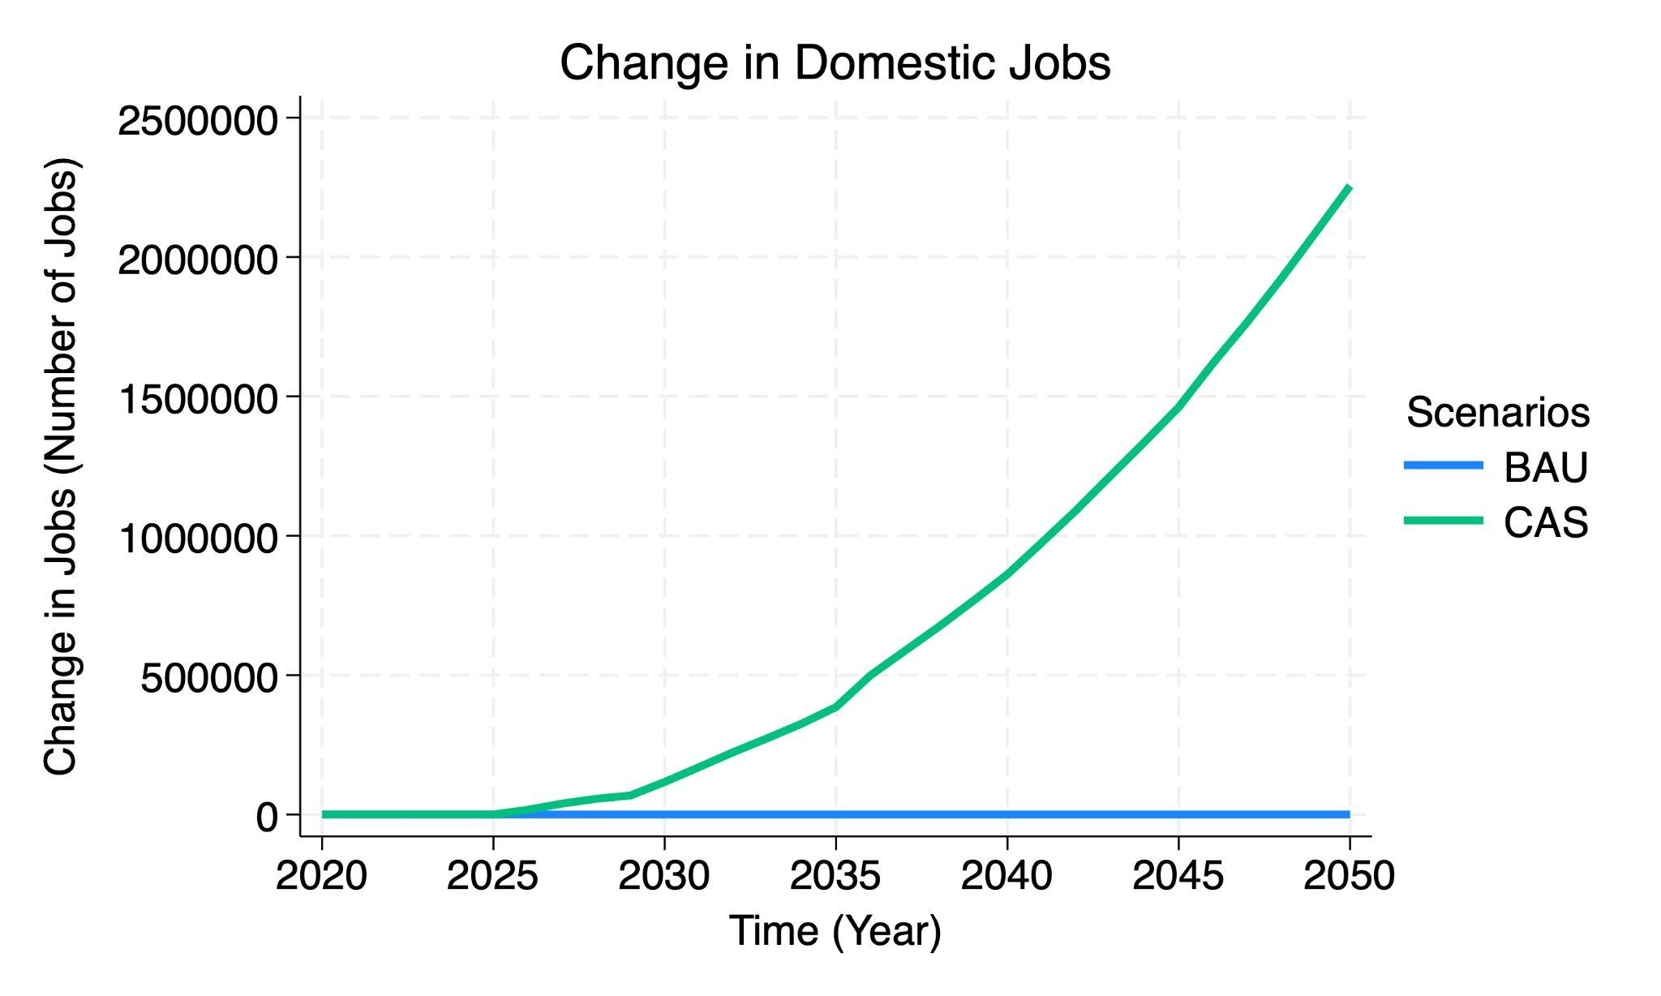
Total Employment in Mexico
The Climate Ambition Scenario policy package has more total jobs in both the short-term and long-term. There are more new green jobs than jobs lost during economic changes.

Slide 36
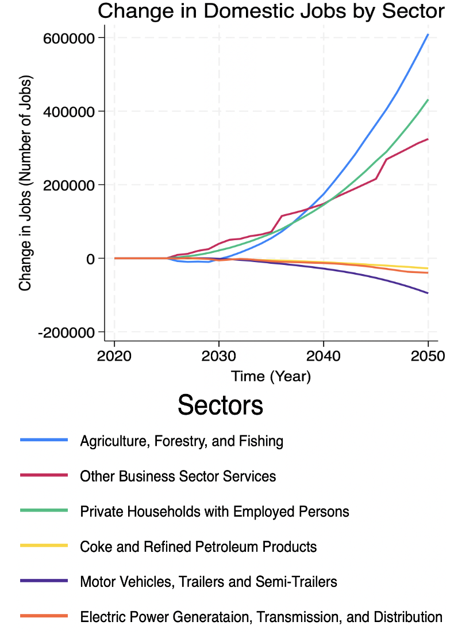
Employment by Most Affected Sectors
The initial job losses from 2026 to 2031 are due to the transition away from animal-based products, as industries related to animal agriculture face declines. However, the policies that drive job creation, such as carbon pricing and regional buy-in initiatives, stimulate new opportunities in agriculture, forestry, and fishing sectors.
The increase in jobs within the private household sector with employed persons is explained by the induced employment generated following the implementation of the policy package. As the policies stimulate economic growth in sustainable industries, household incomes rise, leading to greater demand for domestic services and personal care, which in turn drives job creation in this sector.
The decrease in jobs in sectors such as coke and refined petroleum products, motor vehicles, trailers and semi-trailers, and electricity generation, transmission, and distribution is explained by early retirement policies, the ban on new fossil fuel power plants, and the transition to clean vehicle technologies.
Notes:
THESE ARE THE TOP 3 MOST POSITIVELY AND MOST NEGATIVELY SECTORS, BY JOBS.
Include narrative about informal jobs (54%) and the relevance and benefits to transitioning to more formal jobs.
Consider aspects of Gender Equity and Social Inclusion, particularly in the Private Households with Employed Persons.

Slide 37
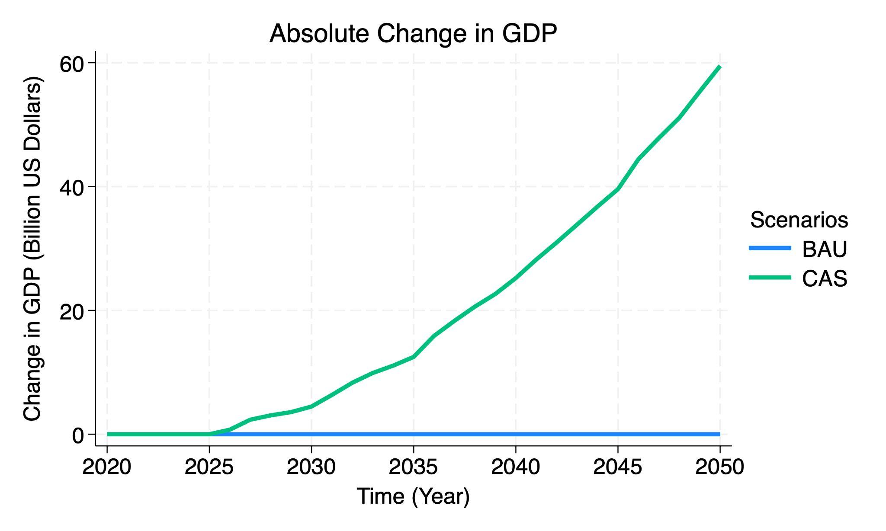
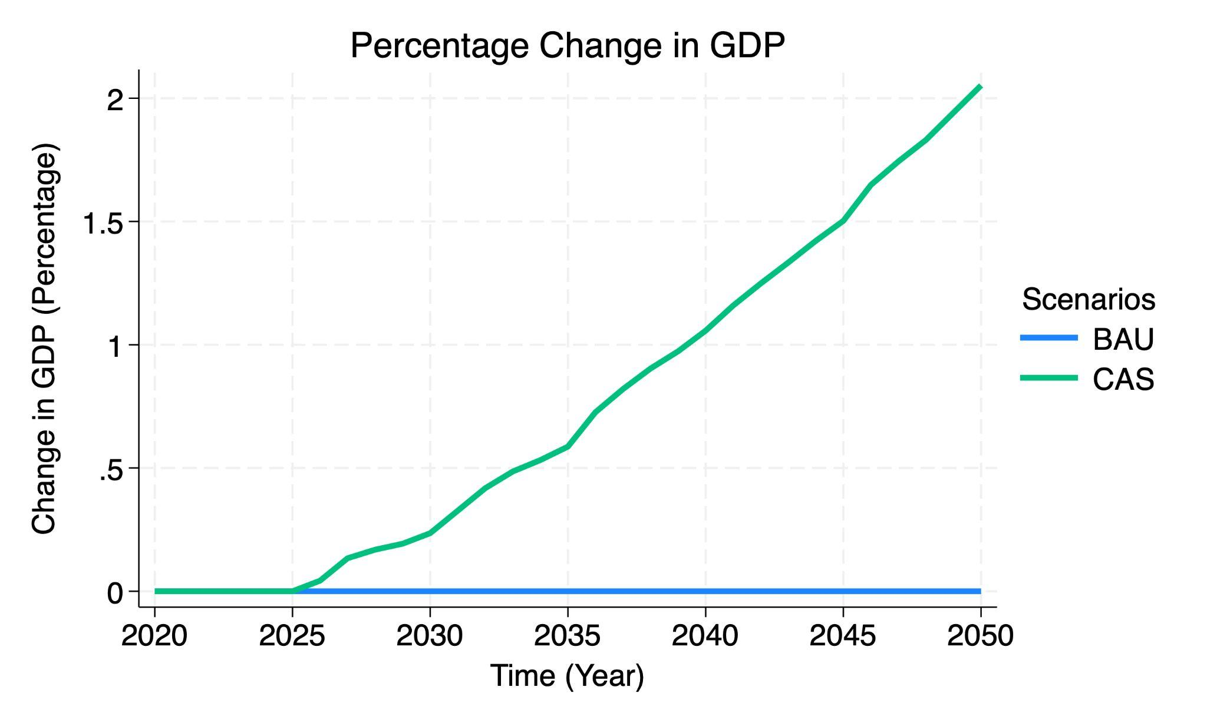
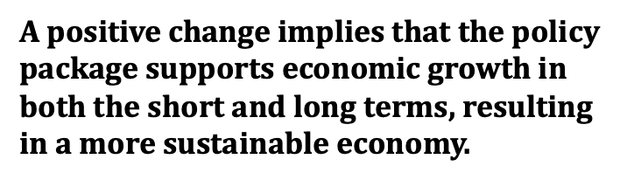
Gross Domestic Product (GDP)

Slide 38
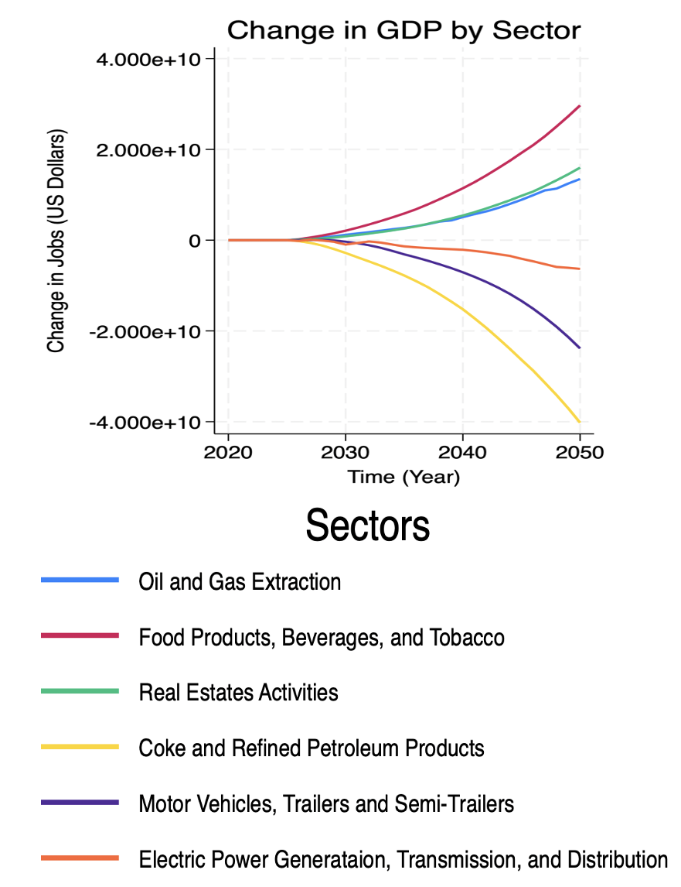
Gross Domestic Product (GDP) by Most Affected Sectors
The policies driving GDP growth, like carbon pricing, regional buy-in initiatives, the shift to renewable energy, and green transportation, stimulate industries such as oil and gas extraction through increased exports, as well as the food, beverages, tobacco, and real estate sectors. Food products benefit from increased demand due to trade. Real estate sees growth from increased business activity and housing demand.
The decrease in GDP in sectors such as coke and refined petroleum products, motor vehicles, trailers and semi-trailers, and electricity generation, transmission, and distribution is explained by early retirement policies, the ban on new fossil fuel power plants, and the transition to clean vehicle technologies.
Notes:
THESE ARE THE TOP 3 MOST POSITIVELY AND MOST NEGATIVELY SECTORS, BY GDP.

Slide 39
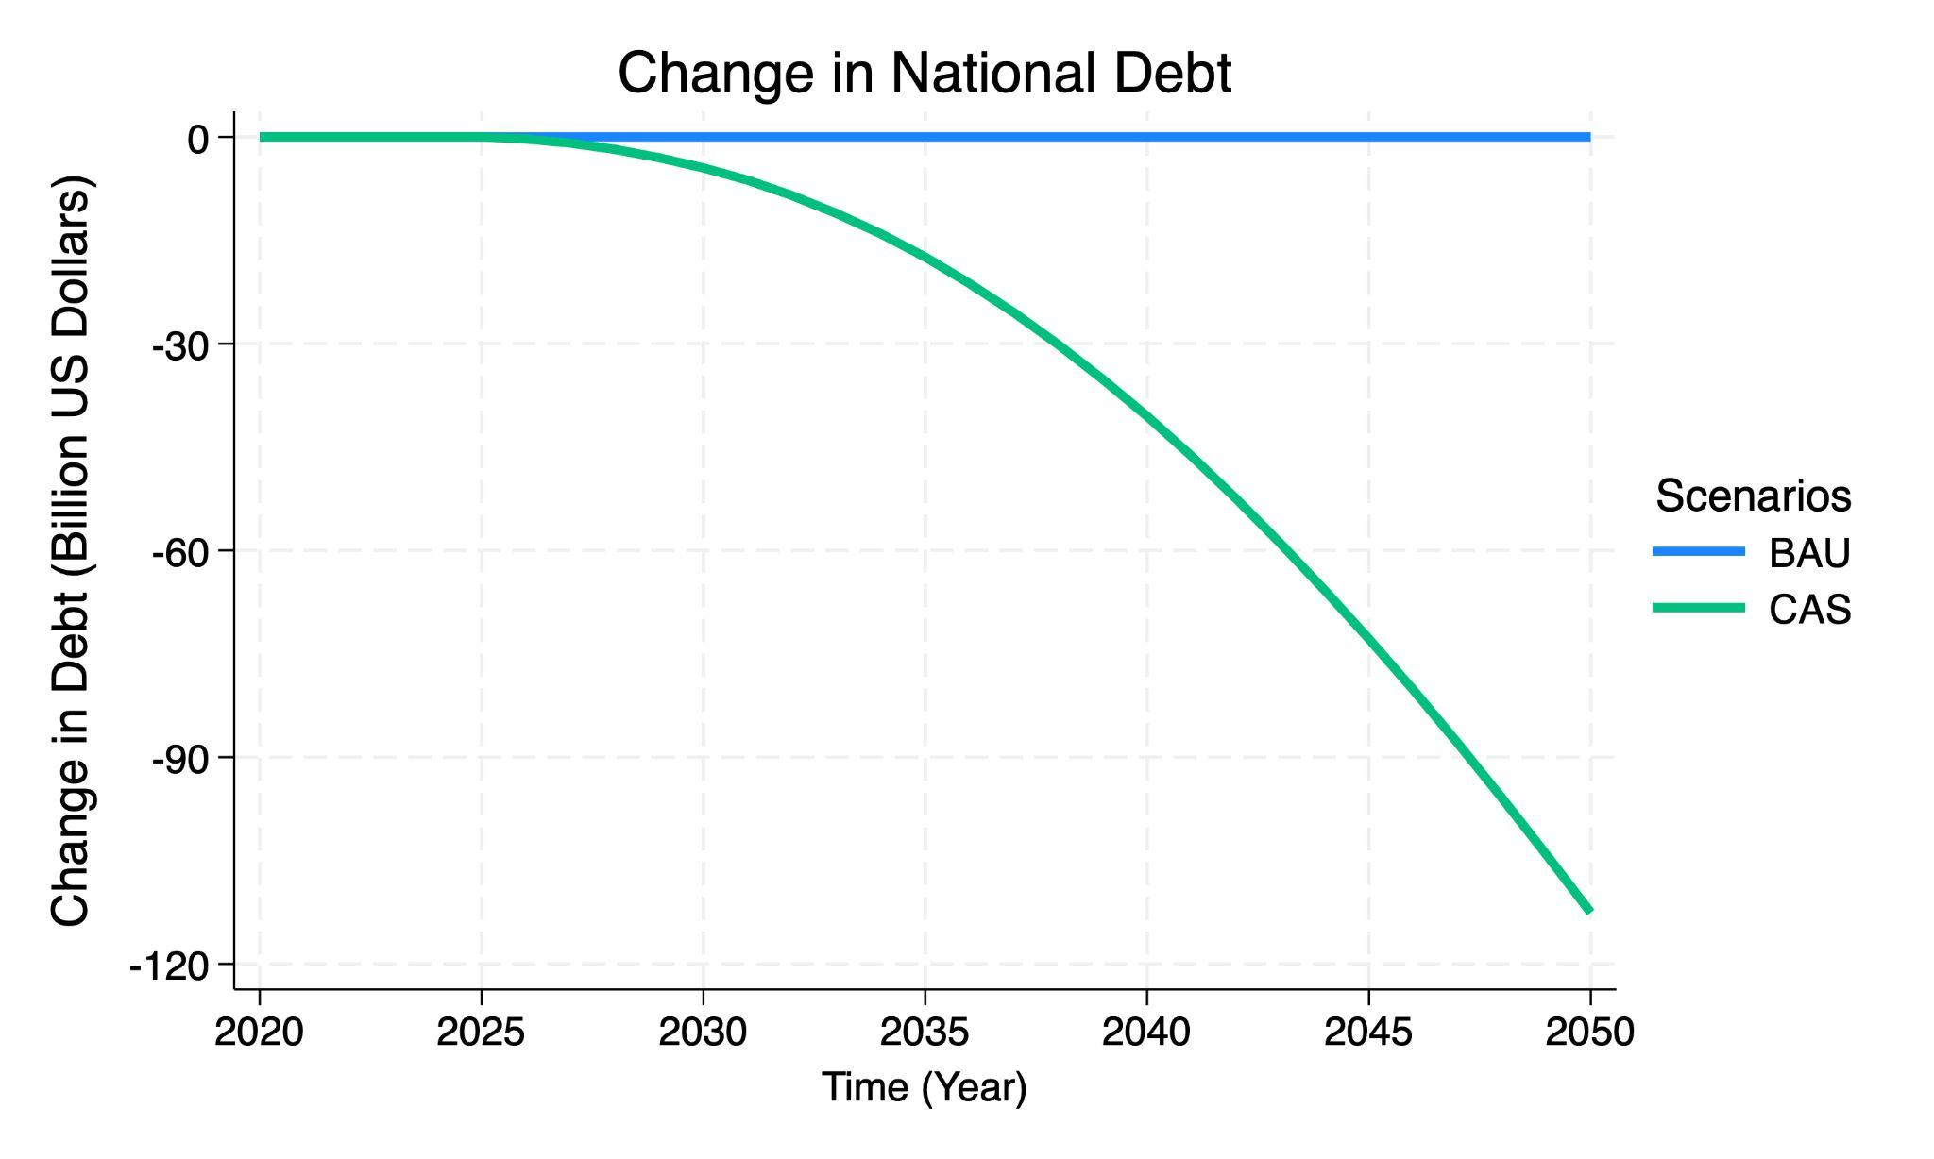
Reduction in National Debt
Mexico is fiscally better.
A negative change in national debt means that the national debt has decreased compared to BAU, indicating that the policy package has increased government cash flow.

Slide 40
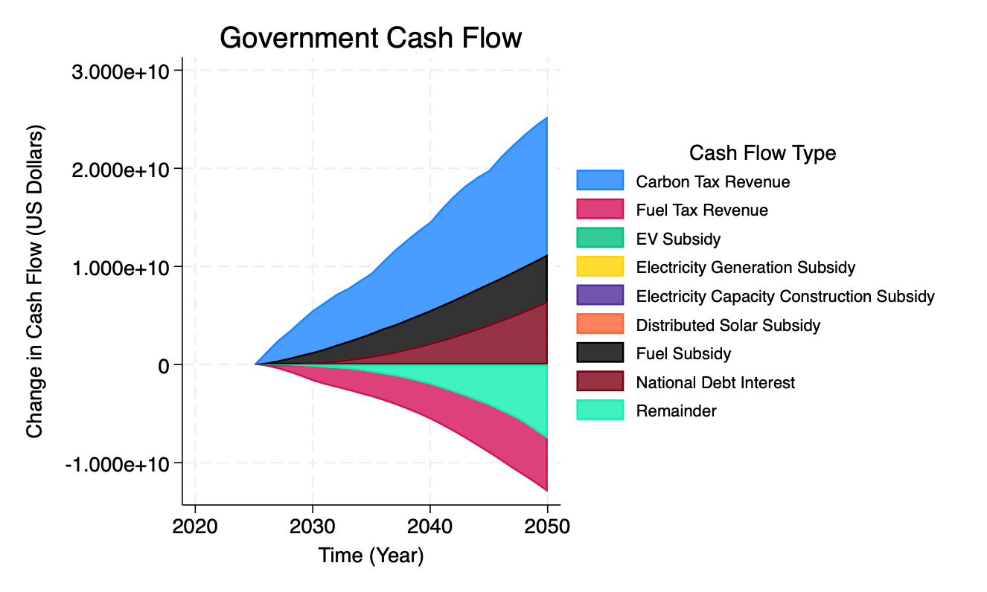
Increased Government Cash Flow
Government cash flows improves because:
Increased carbon tax revenue
Decreased of fuel subsidy expenditures
Reduced interest payments on national debt
These offset a reduction in fuel tax revenue and miscellaneous “Remainder” spending
Notes:
Describe narratively the allocation of revenues, specially for carbon tax, for social/household programs.

Slide 41
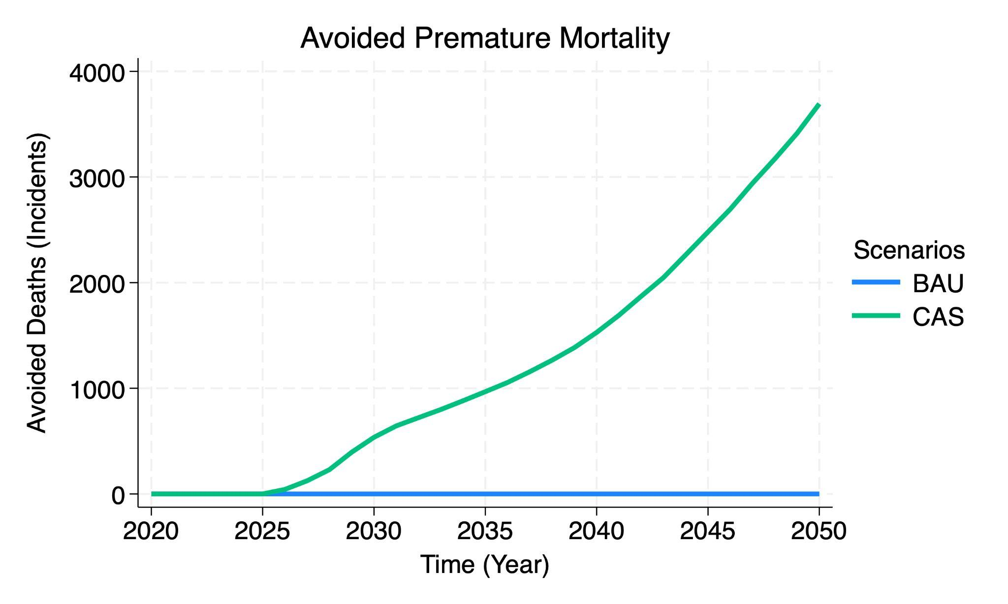
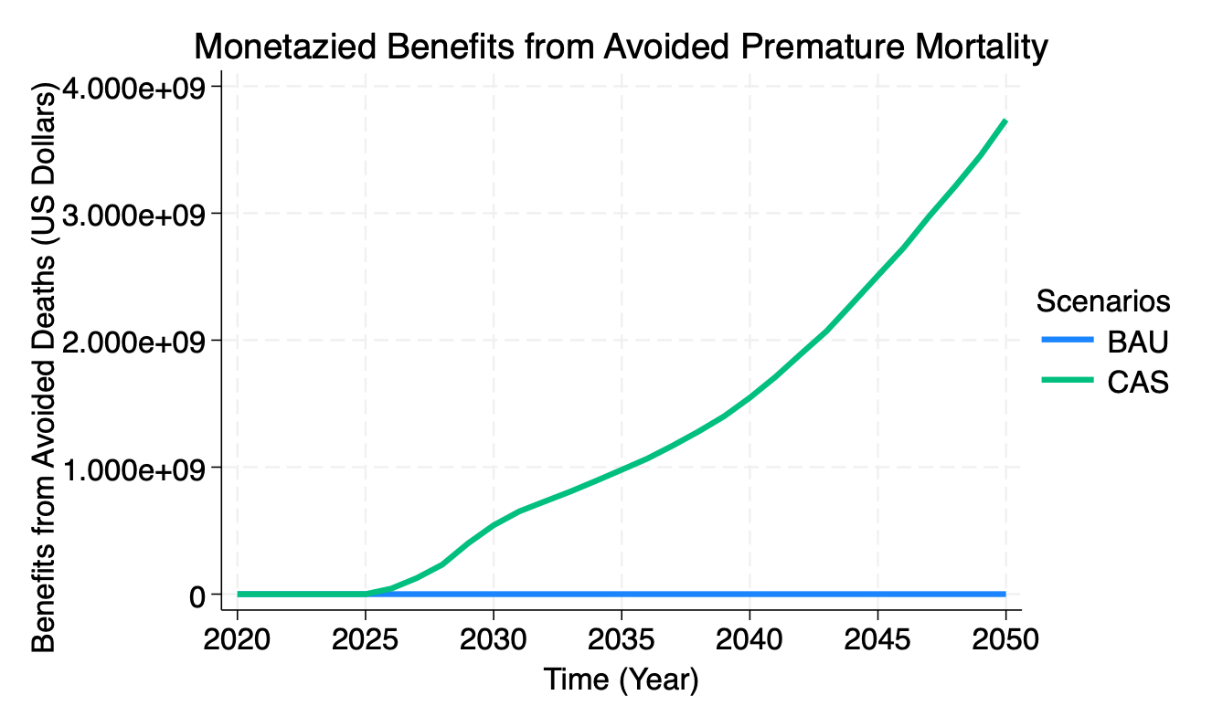
Health Benefits
Moving away from fossil fuels (coal, fuel oil and natural gas) and switching to more sustainable modes of transport, can bring health benefits associated with the reduction of criteria pollutants such as PM, SO2, NOx, carbon monoxide and black carbon.
Air quality improvements avoid 3,693 deaths by 2050.

Slide 42
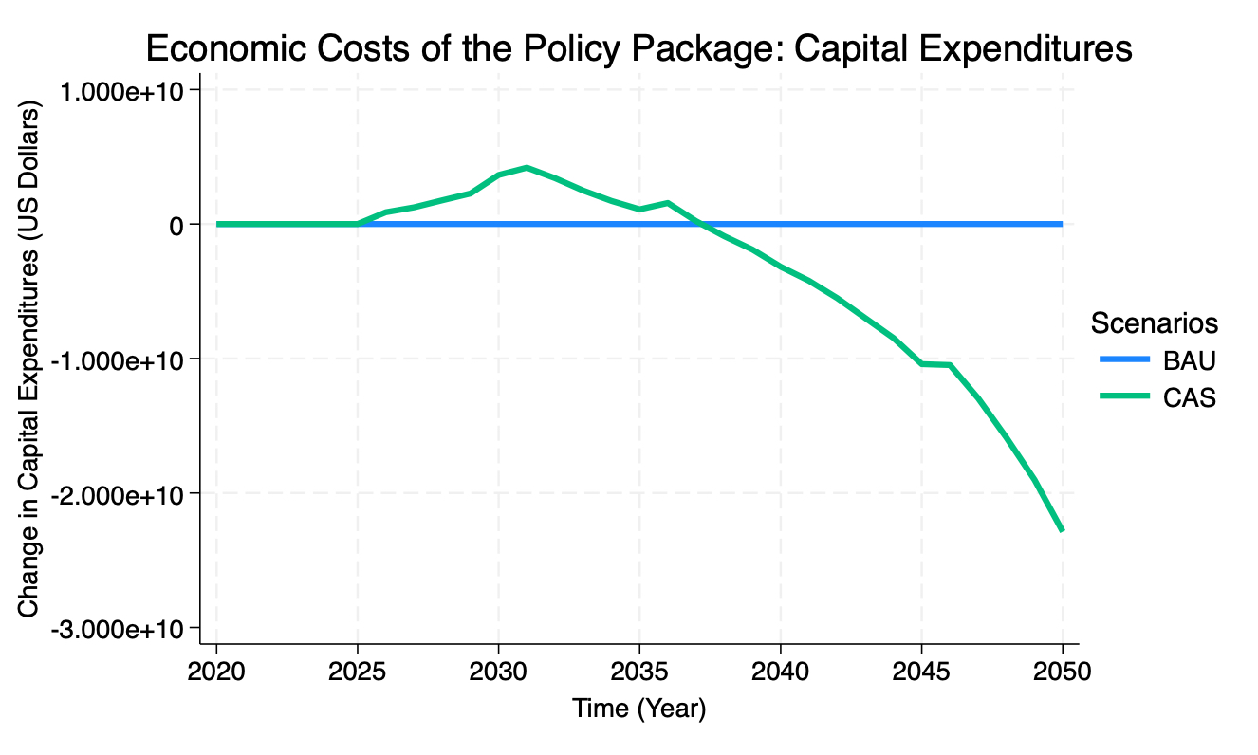
Economic Cost of the Policy Package
Capital Expenditures

Slide 43
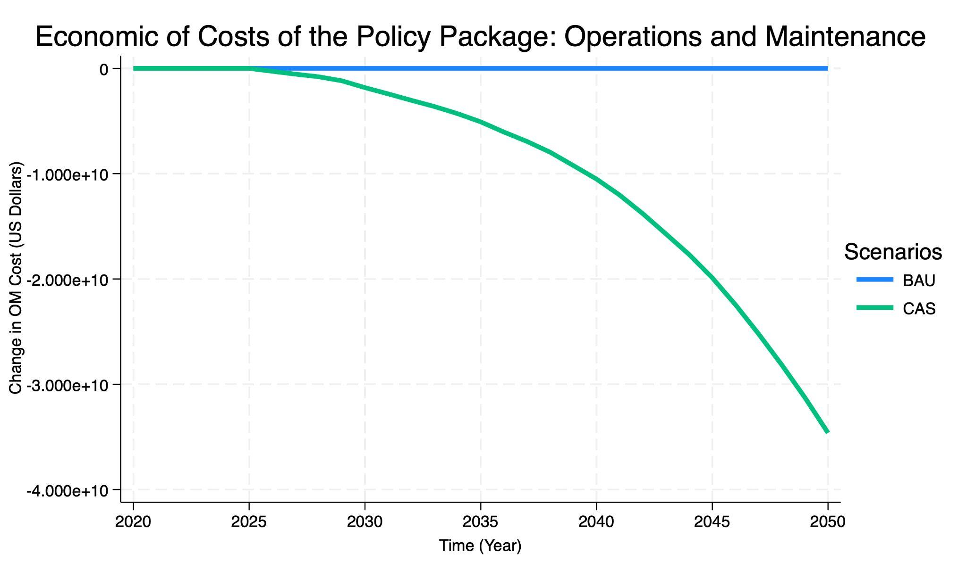
Economic Cost of the Policy Package
Operations and Maintenance

Slide 44
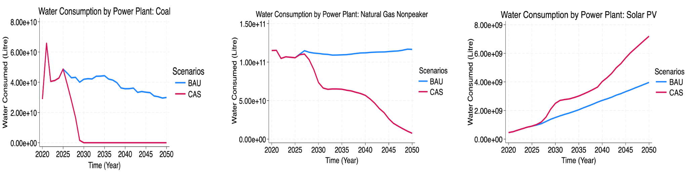

Water Consumption by Power Plant

Slide 45

Water Consumption by Power Plant

Slide 46

Table with GHG emissions by Sector 2020–2050

